Slide 1


Utilizing Genome Fingerprinting to Conclusively Pair Tumor-Normal WES Data for Adaptive T-Cell Therapy
EARLE A. CHILES RESEARCH INSTITUTE
Project By: | Alex Sathler
Thanks to: | Venkatesh Rajamanickam Joe Slagel Christopher Dubay Brady Bernard
Notes:
Is this for this slide or the next slide?

Slide 2
Background: Project Description and Fingerprinting Method by Gustavo Glusman
EARLE A. CHILES RESEARCH INSTITUTE

Slide 3
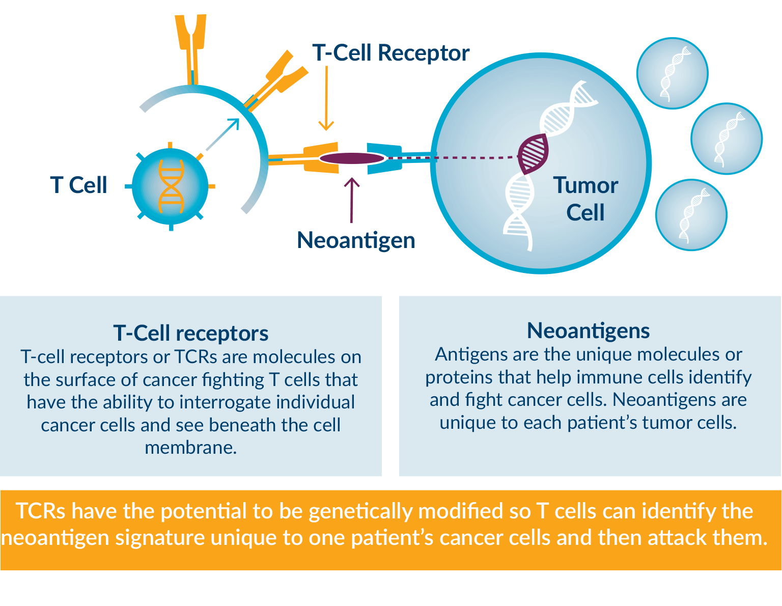
T-Cell Therapy: Teaching your body to attack tumors
A method of training your immunity to recognize tumor epitopes.
A very good example of personalized medicine
Requires that the patient and the tumor are paired throughout treatment – you don’t want to train a patient’s T-cells to deal with another patient’s tumor
Begs the Question…
https://www.cbinsights.com/research/report/what-are-neoantigen-vaccines-personalized-cancer-treatment/

Slide 4

How can we know, without question, that a tumor comes from a specific patient?
This is where genome fingerprinting comes into play…
https://www.stickpng.com/img/icons-logos-emojis/question-marks/question-mark-drawing

Slide 5
The Theory Behind Genome Fingerprinting:
Single Nucleotide Variants (SNVs) – Small mutations in the genetic code. Every one has them, no one has the exact same mutations.
Even different samples (especially mutation-rich tumor samples) from the same individual will have very different variants
This is leveraged to create a unique genetic fingerprint for the sample in question.
https://www.garvan.org.au/research/kinghorn-centre-for-clinical-genomics/learn-about-genomics/for-gp/genetics-refresher-1/types-of-variants

Slide 6
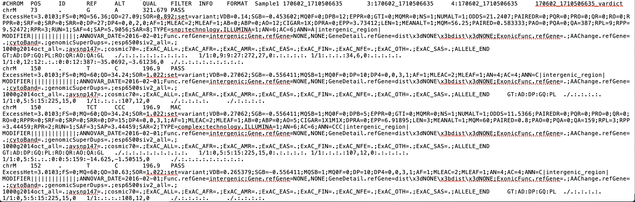
Compressing Exomic SNV Data
Entire genomes are very large: ~1.5 gigabytes
How can that data be condensed in a way to uniquely identify an genome?
Use exomic data – this project is for pairing tumor samples with normal samples. Gene expression is what determine the tumor
Use Variants only – Variant Call Format (.vcf)
Condense SNVs in a .vcf into a unique genetic fingerprint – thank you Gustavo Glusman!

Slide 7
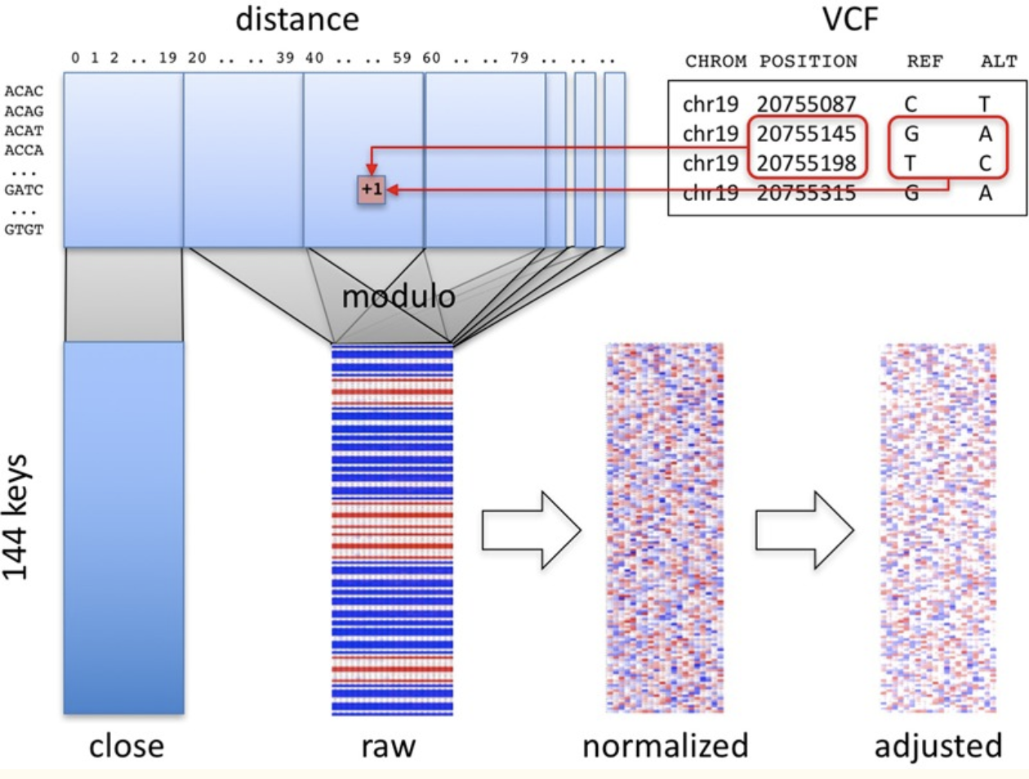
https://www.ncbi.nlm.nih.gov/pmc/articles/PMC5623000/

Slide 8
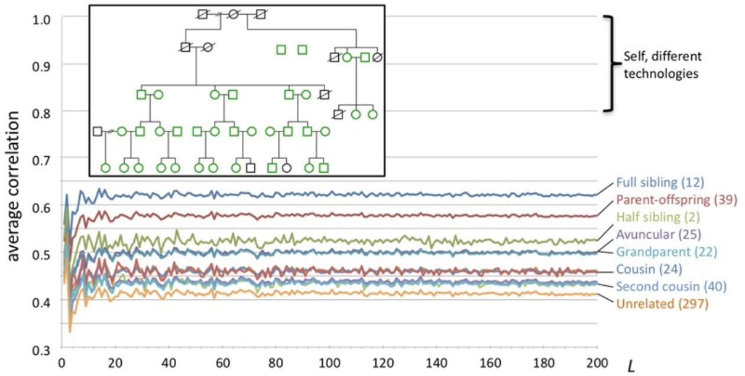
Verifying the Method:

Slide 9
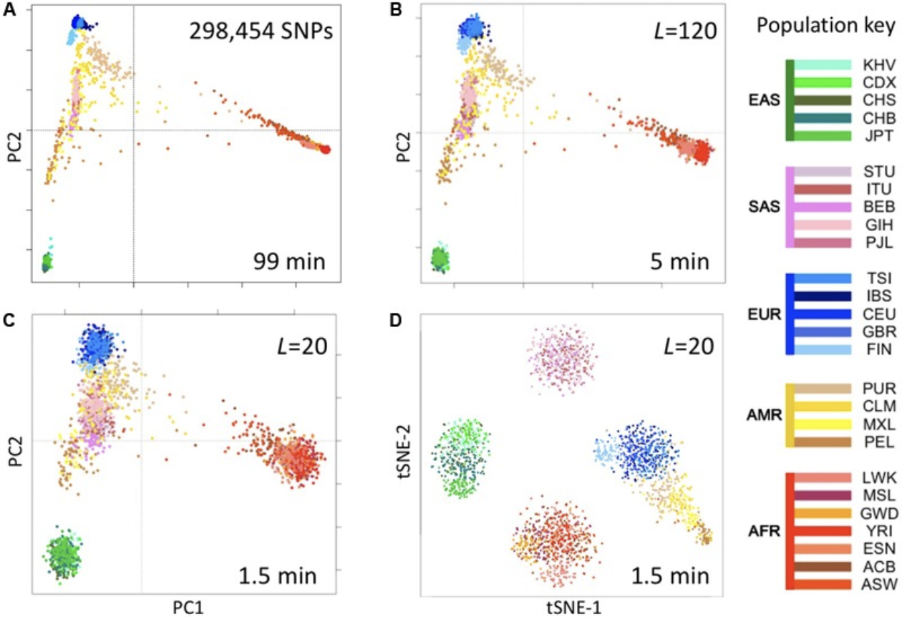
More Verification:

Slide 10
First Steps: Prototyping the Method with a Test Dataset
EARLE A. CHILES RESEARCH INSTITUTE

Slide 11
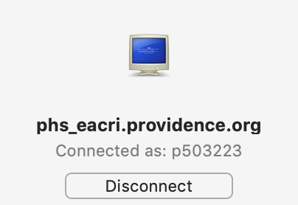
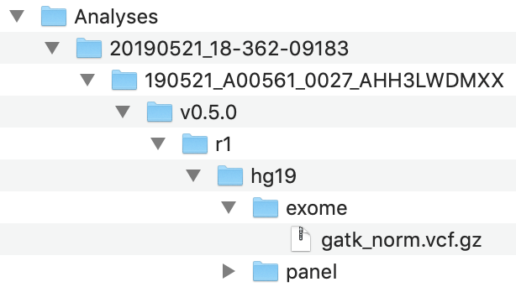
Venkatesh’s Data Dump: 14 GATK_norm samples
GATK is an algorithm that looks through the reads for a genome and finds variants
Different algorithms are specialized at reading variants in different ways
GATK is great for reading germline variants vs tumor variants because it is very selective about what reads it logs in the .vcf file

Slide 12
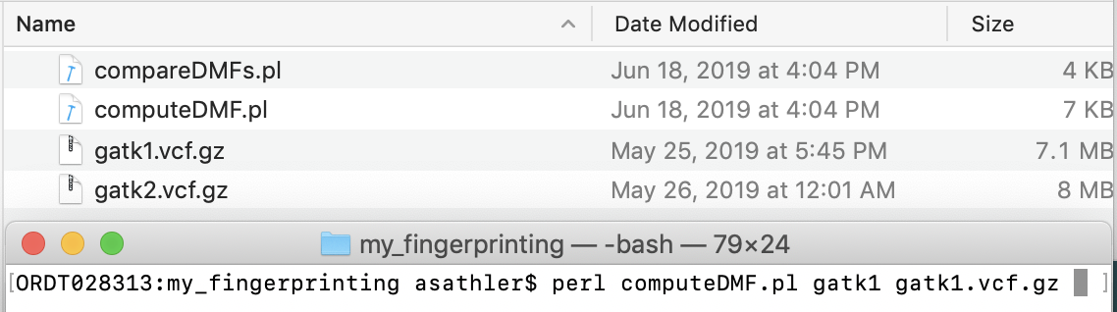
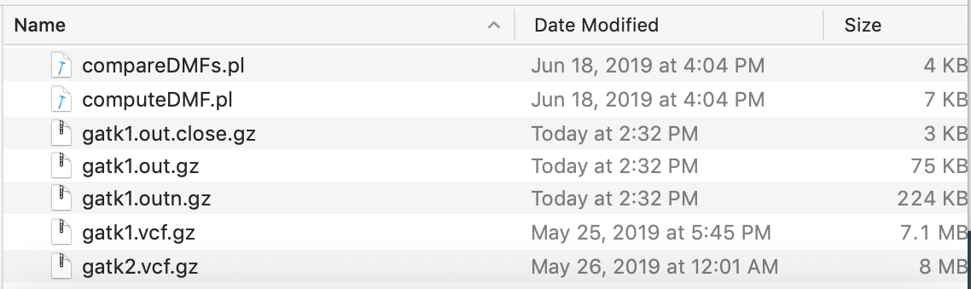
Creating Fingerprints…

Slide 13
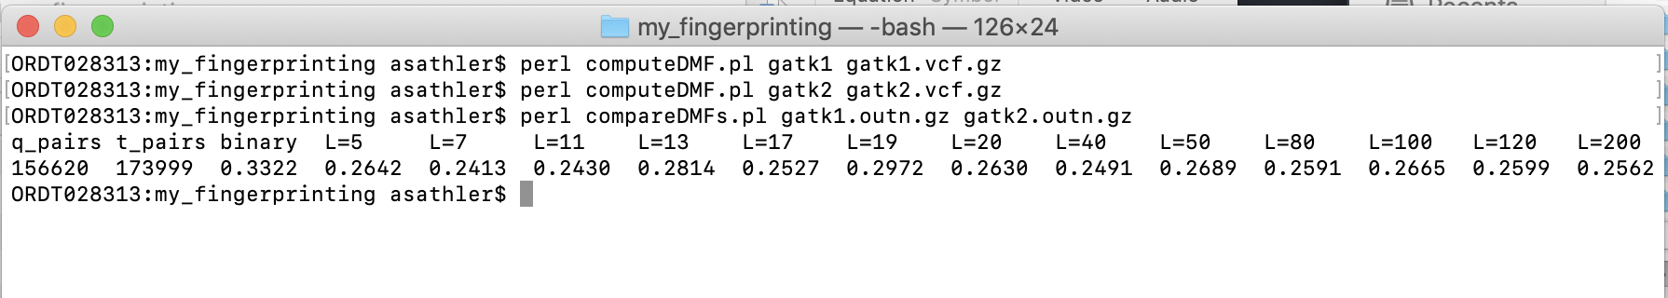
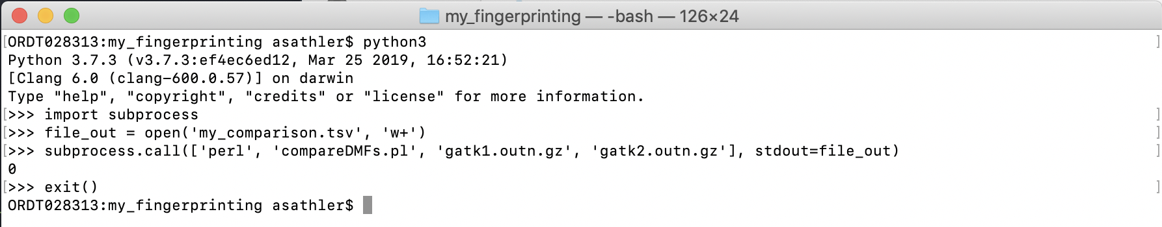
Comparing Fingerprints…

Slide 14
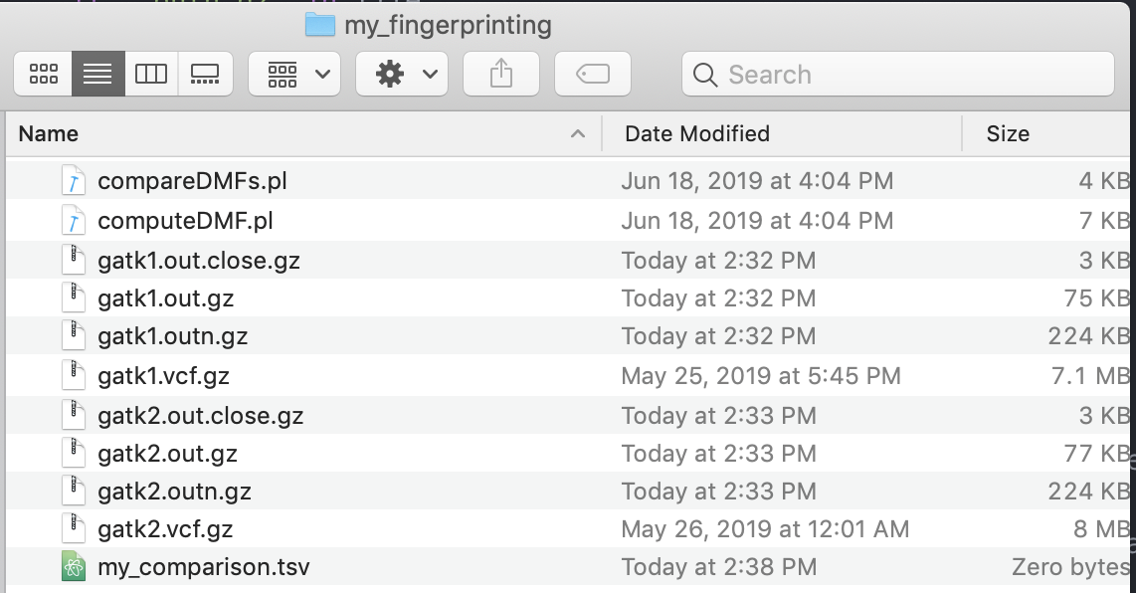
Bringing it to Python…

Slide 15
So how did the process go for the 14 samples in the experimental data dump?

Slide 16
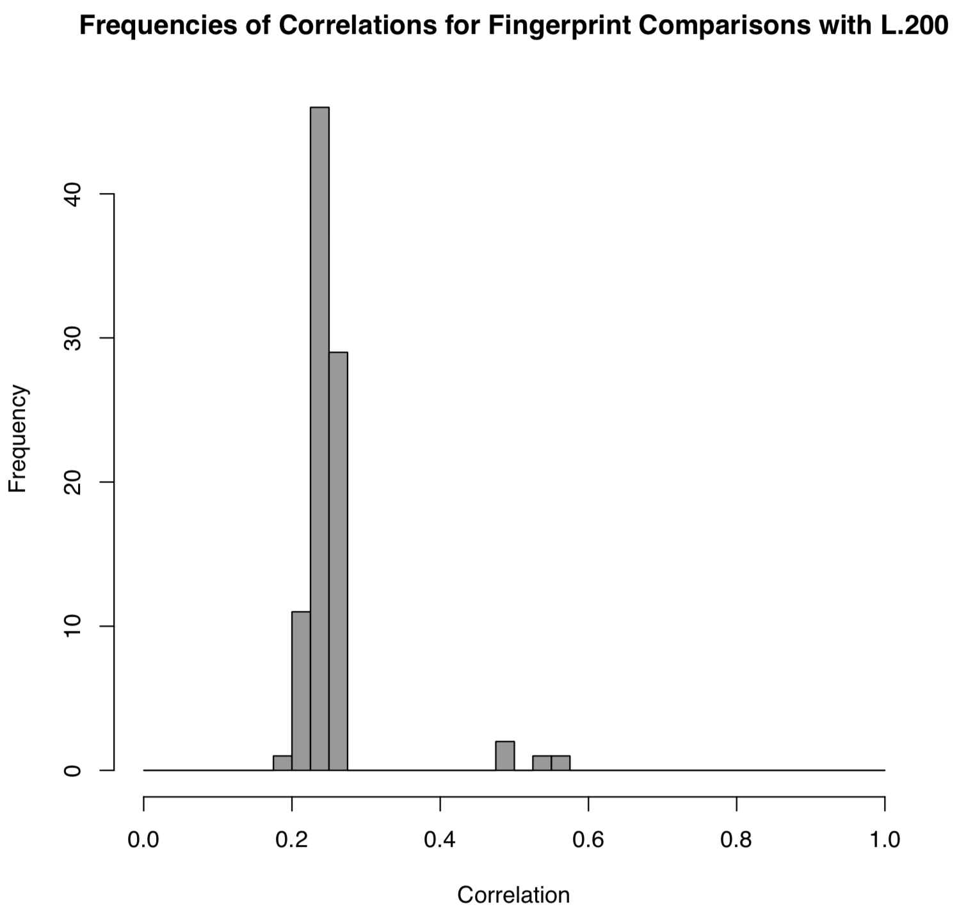
Unfiltered Correlations for 14 Samples that were recently Sequenced:
Uses GATK_norm.vcf
Very good separation in the correlation distribution
When identifying which comparisons are where, tumor-normal-pair samples are higher correlation, all other samples are low correlation

Slide 17
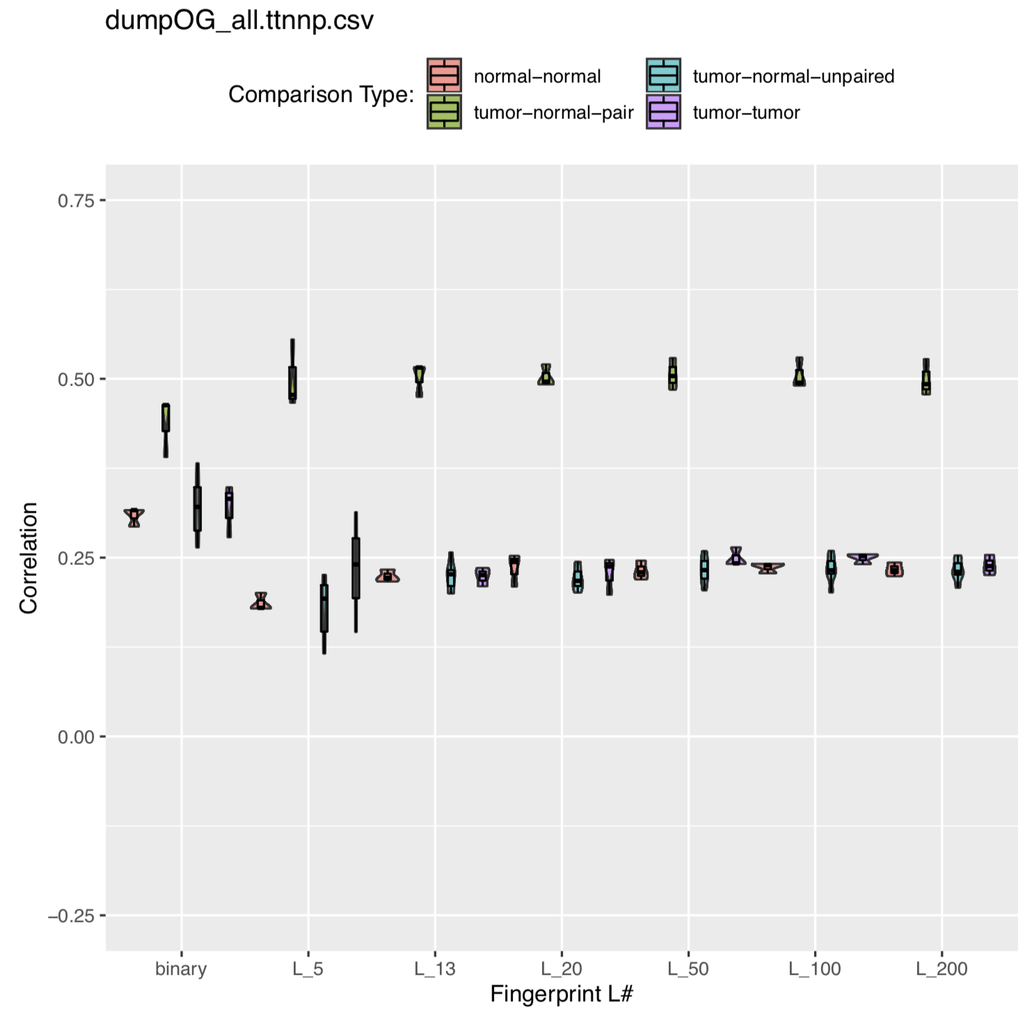
Correlations for Different Comparison Types 14 Samples from recent GATK_norm Sequencing

Slide 18
Great! So now let’s give it a try for a more realistic dataset…

Slide 19
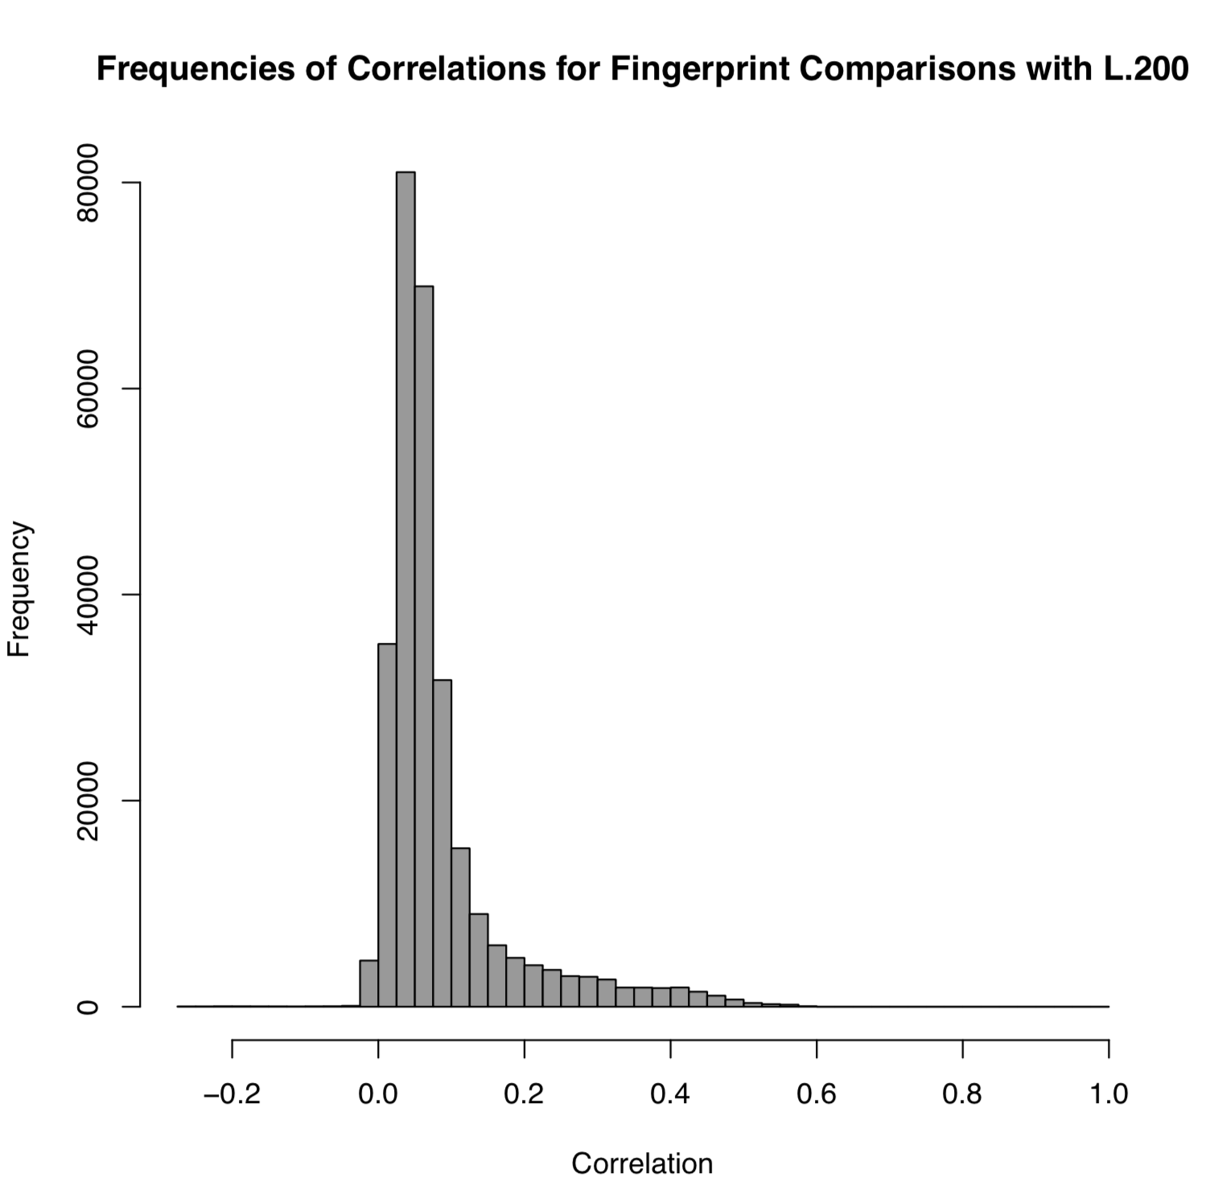
Unfiltered Correlations for 758 samples in v050 of the pipeline
This is using ann.vcfs rather than GATK_norm.vcfs
Notice the lack of separation in the data – a continuous distribution skewed to the right.
We wanted to see a separation... Now it’s time to figure out why we didn’t

Slide 20
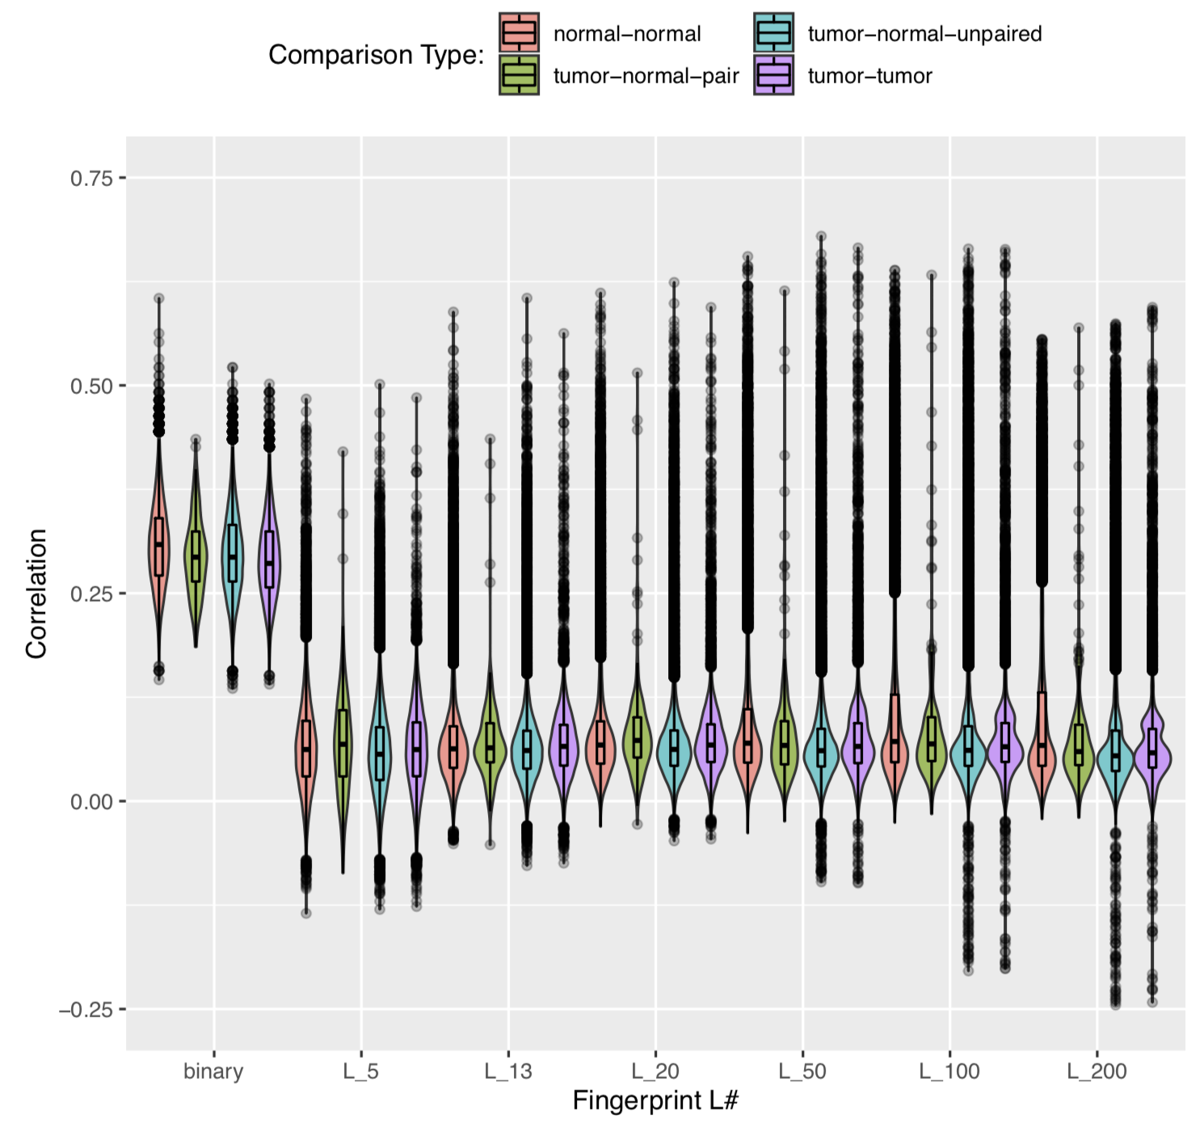
Correlations for Different Comparison Types of 758 Samples in v0.5.0 of the Pipeline

Slide 21
Part Two: Filtering out the Noise
EARLE A. CHILES RESEARCH INSTITUTE

Slide 22
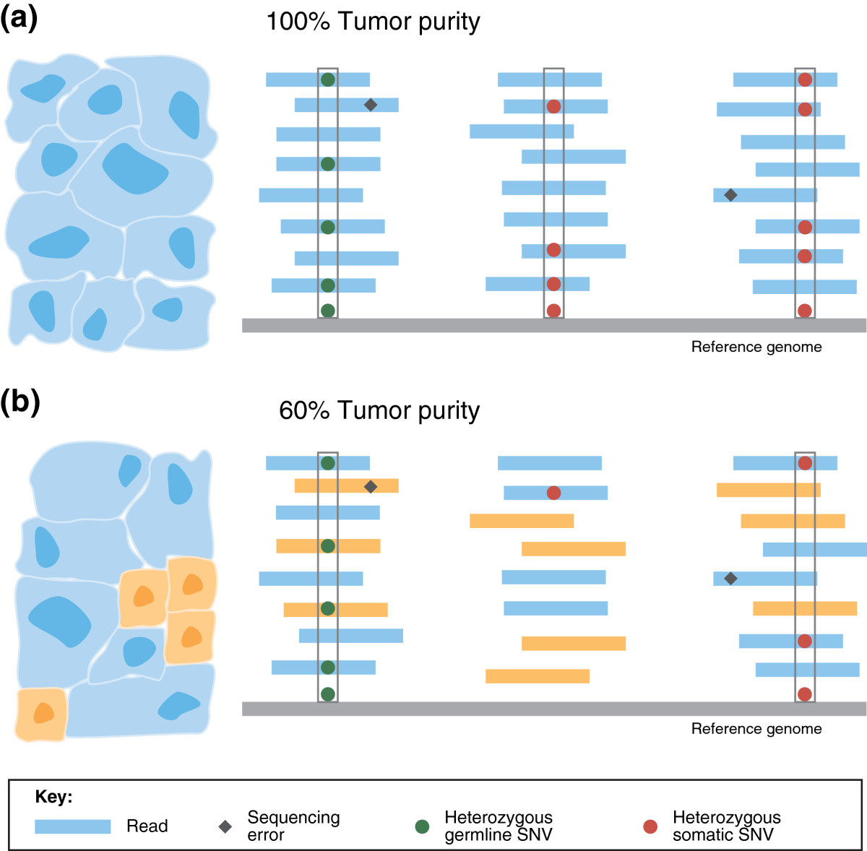
To know what an how to filter, we must understand how sequencers work…
'Normal’ (Germline) SNVs:
Somatic SNVs
Germline, in this circumstance, is sequenced from blood samples
These SNVs are found in normal tissue AND tumor tissue
SNVs garnered starting during zygote formation and accumulated throughout life
The somatic genome is sequenced from a tumor sample. It is very rare for these samples not to have normal tissue ‘impurities’
These are the most interesting SNVs because they are not found in normal tissue – implying that they caused tumor formation
https://genomemedicine.biomedcentral.com/articles/10.1186/gm524

Slide 23
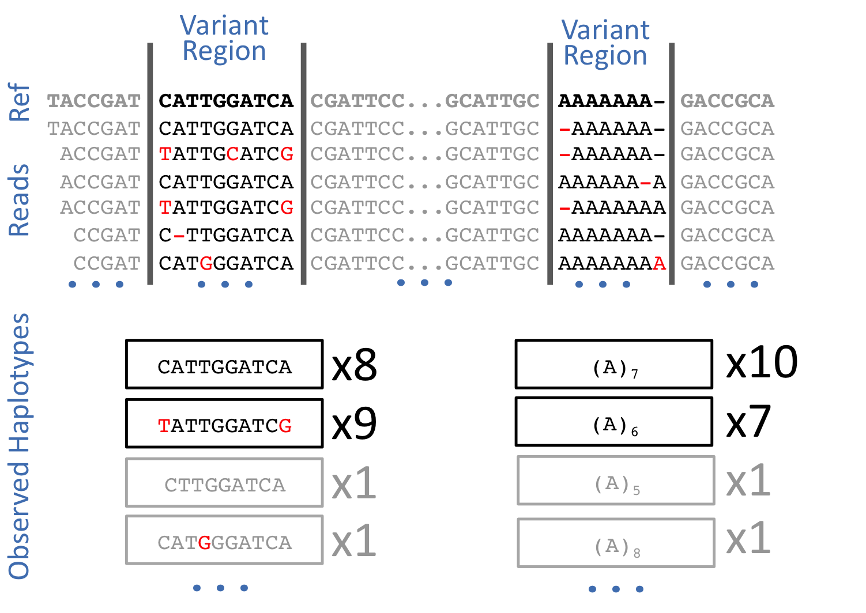
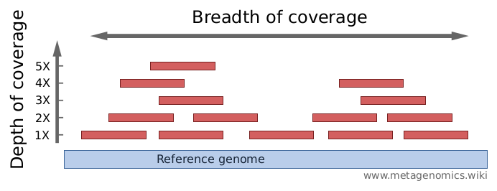
How Genome Sequencing Works:
Several hundreds or thousands of primers are used to start sequencing. Sequencing then occurs for a set number of base-pairs after the primer
Which primers are used and how many BP are sequenced after the primer determines read depth: how many times the genome was sequenced at a single locus
At EACRI, Germline samples normally has depth ranging from 50 – 70 reads. Tumore samples have read depth ranging from 100 – 200 reads.
Variants are found by comparing the sequencing data to a reference genome
Any given locus will have a number of normal reads and a number of variant reads, leading to variable variant allele frequency
https://hbctraining.github.io/In-depth-NGS-Data-Analysis-Course/sessionVI/lessons/02_variant-calling.html
https://bioinformatics.stackexchange.com/questions/2726/what-is-deep-sequencing

Slide 24
How the EACRI Pipeline Works
1. SEQUENCING
2. ALIGNMENT
Hiseq-2500, Hiseq-4000, Novaseq sequences the exome of the desired Tumor/Normal samples
Unaligned reads are aligned to human genome reference
3. SNV and INDEL PROCESSING
4. ANNOTATION
Once aligned reads are processed and clean, mutation calling algorithms are used to find SNV and INDELs
Mutations found are further annotated with databases such as EXAC, 1000G Project, COSMIC, TCGA etc.,

Slide 25
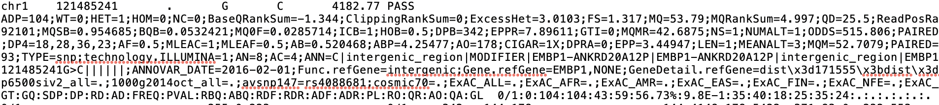
The format column from the SNV read above:
Varscan, GATK, Samtools, Freebayes, Vardict (in order):
DP: Total Allele Depth
AD: Variant Depth or Variant vs. Reference Calls
VD: Like AD. Only found in a few callers.
FREQ: A VAF percentage.

Slide 26
How Different Filters Effect Comparison Correlations:

Slide 27
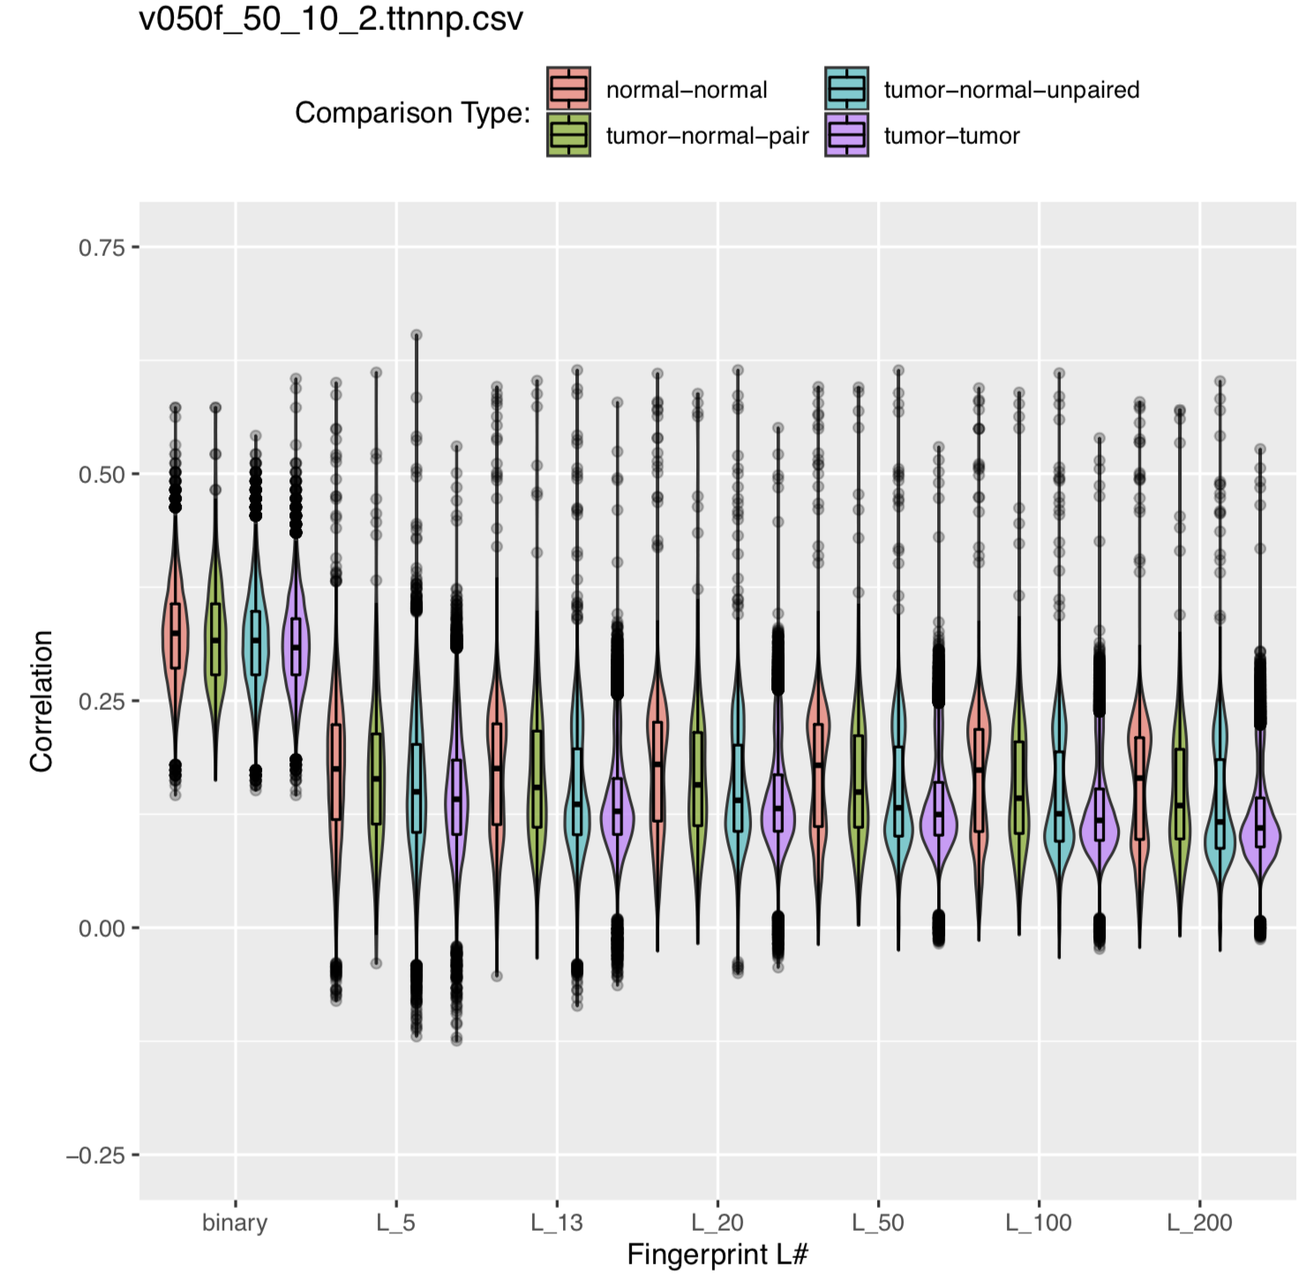
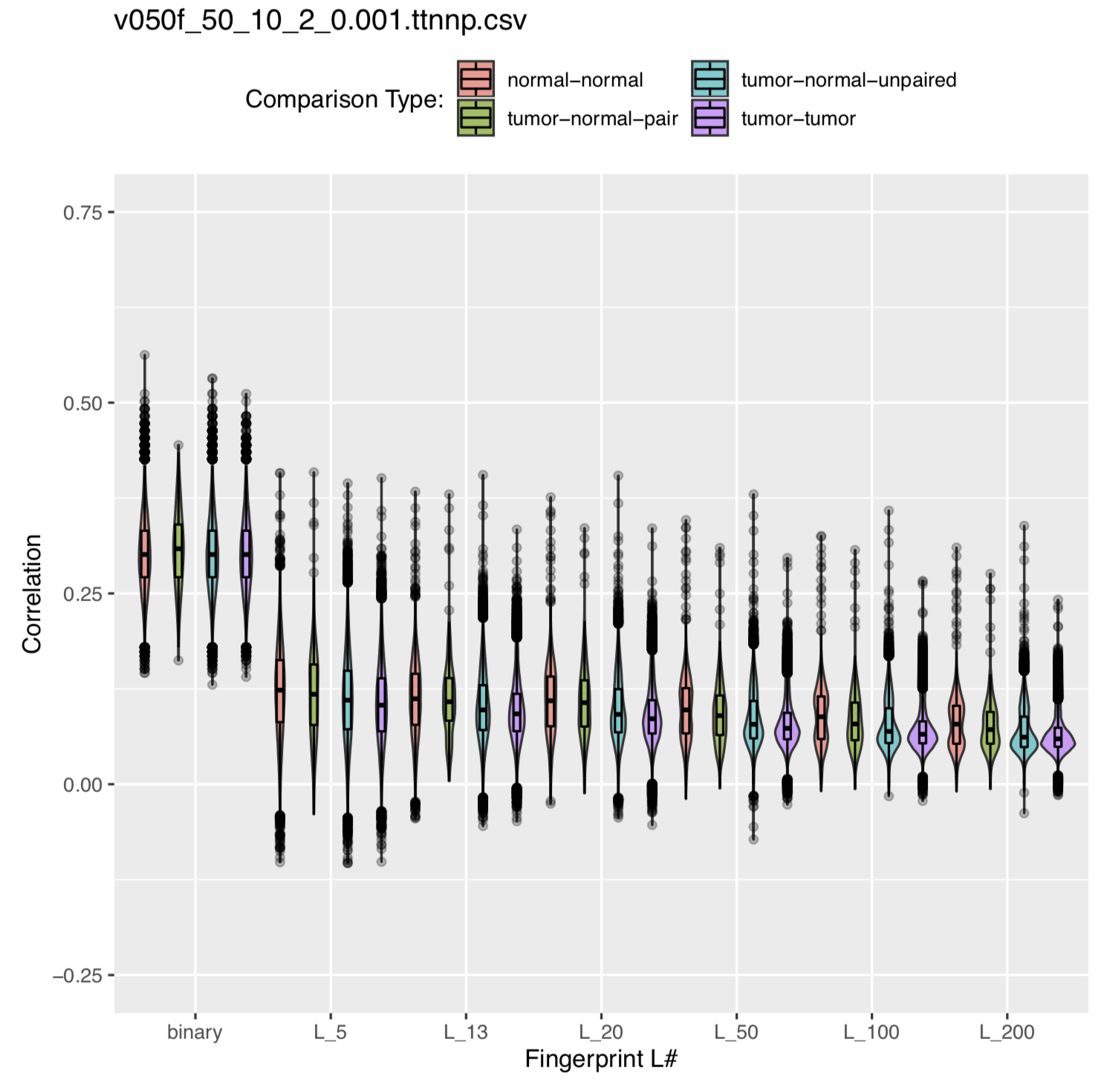
How Different Filters Effect Comparison Correlations:
Unfiltered
Sequencing Filter
Reference Population Filter + Sequencing Filter
Many, many outliers
Tight distribution when not considering outliers
Minimum Allele Depth 50, Minimum Variant Allele Frequency 10%, Minimum Number of Algorithms Called 2
Wider distribution, fewer outliers
Same filters as left plus 0.001 maximum reference population frequency
Tighter Distribution and Fewer Outliers

Slide 28
So Filtering by SNVs read variables didn’t have the desired effect…
How does fi

Slide 29
If a tumor sample and a normal sample are paired, their germline SNVs should be consistent.
This helps explain why the larger v050 dataset was not providing the correlation distribution we saw with the smaller dataset.
This dataset used ann.vcf, not GATK_norm.vcf
Again, different callers are good at finding different type of SNVs:
Varscan: A very permissive caller. Picks up just about any SNV
GATK: A stringent caller that focuses on outputting Germline SNVs
Samtools: Like GATK
Freebayes: Like GATK
Vardict: More of a Somatic Caller
So ann.vcf includes variants from permissive and somatic callers (Varscan and Vardict), which throws a wrench in comparing the Germline SNVs in the normal sample to the Germline SNVs in the Tumor Sample.

Slide 30
How Different Callers Affected Distribution of Correlations for Fingerprint Comparisons
The 758-sample dataset took days to process, so a much smaller 25 sample dataset was adopted for testing…

Slide 31
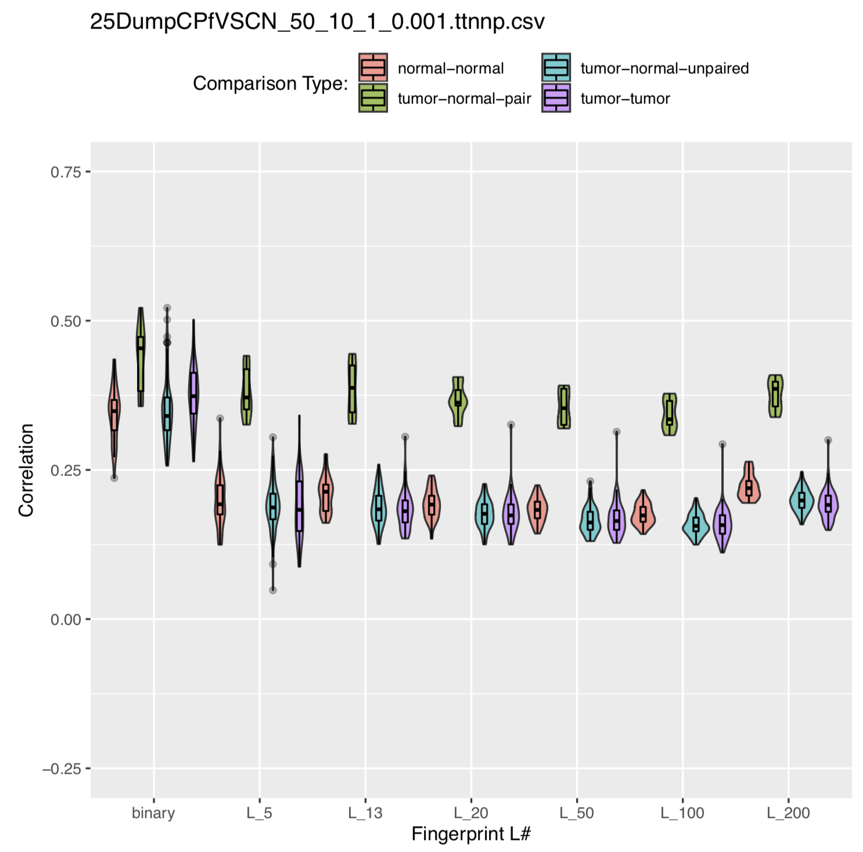
Correlations for Different Comparison Types for Varscan Only in the 25-Sample Dataset

Slide 32
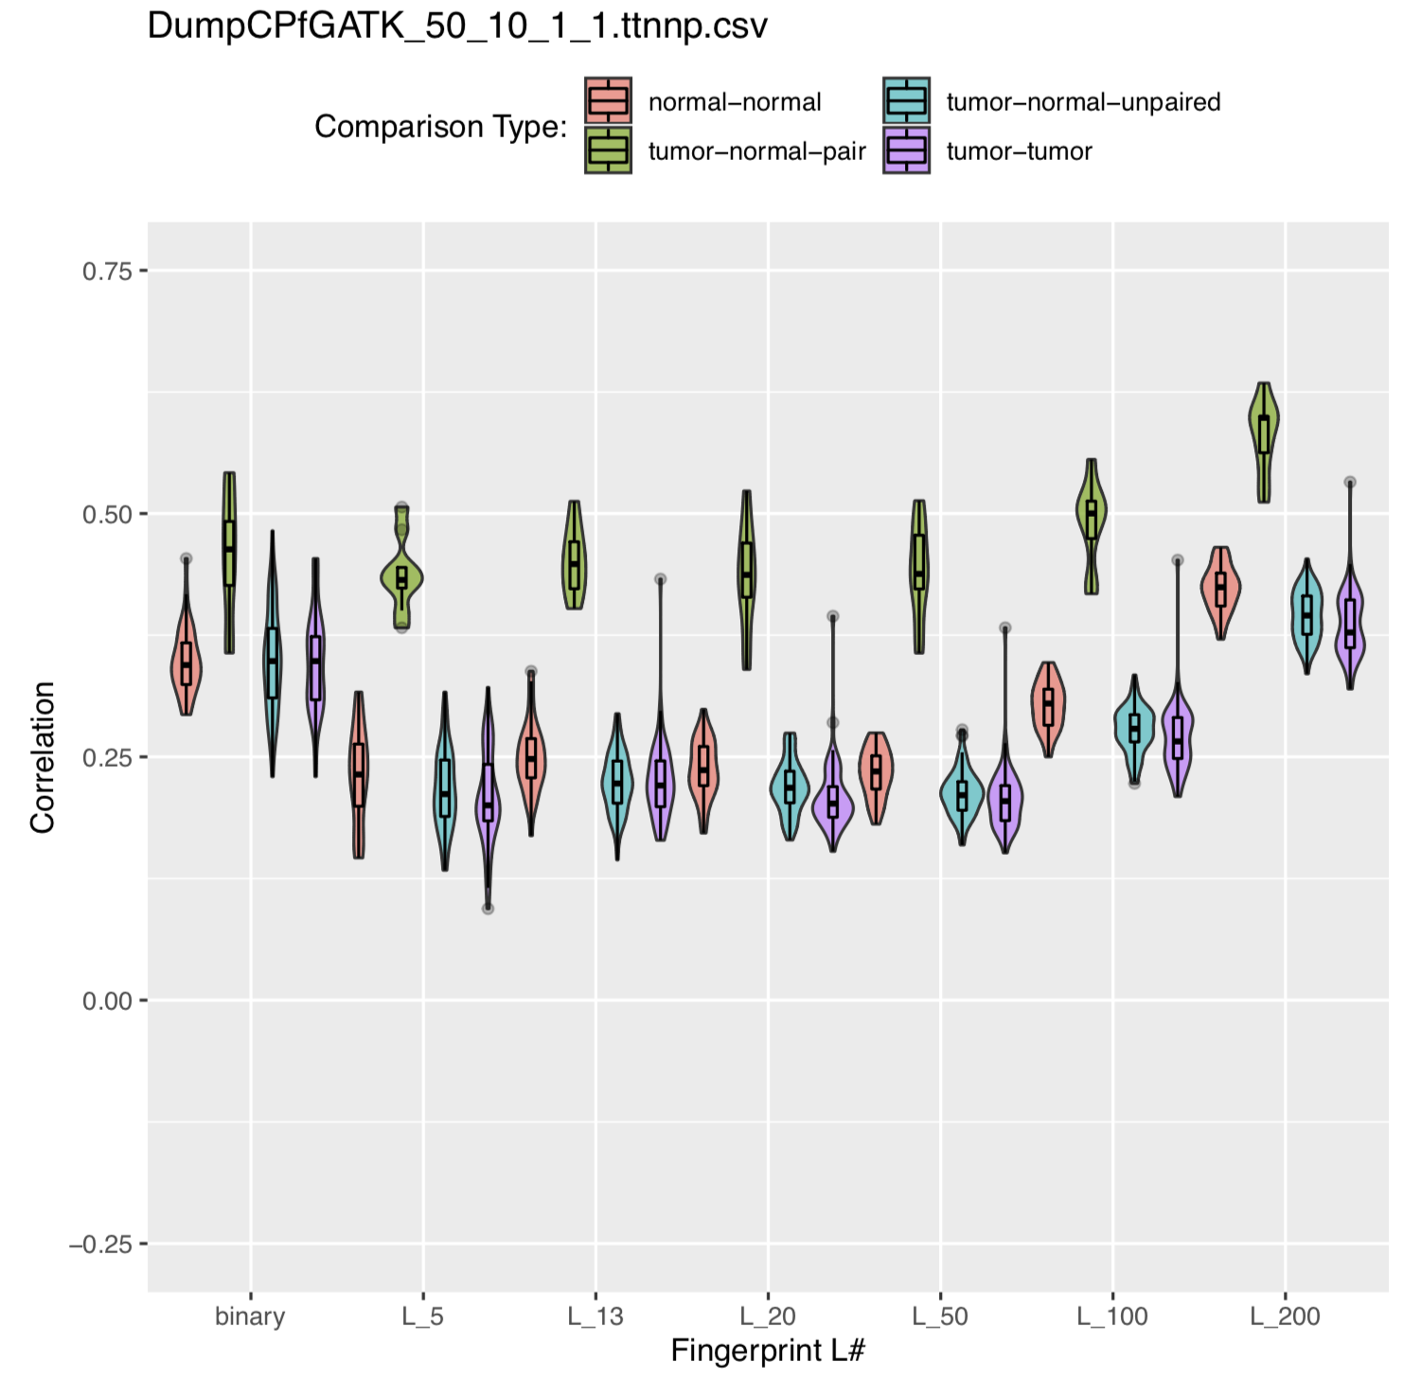
Correlations for Different Comparison Types for GATK Only in the 25-Sample Dataset

Slide 33
Correlations for Different Comparison Types for Freebayes Only in the 25-Sample Dataset

Slide 34
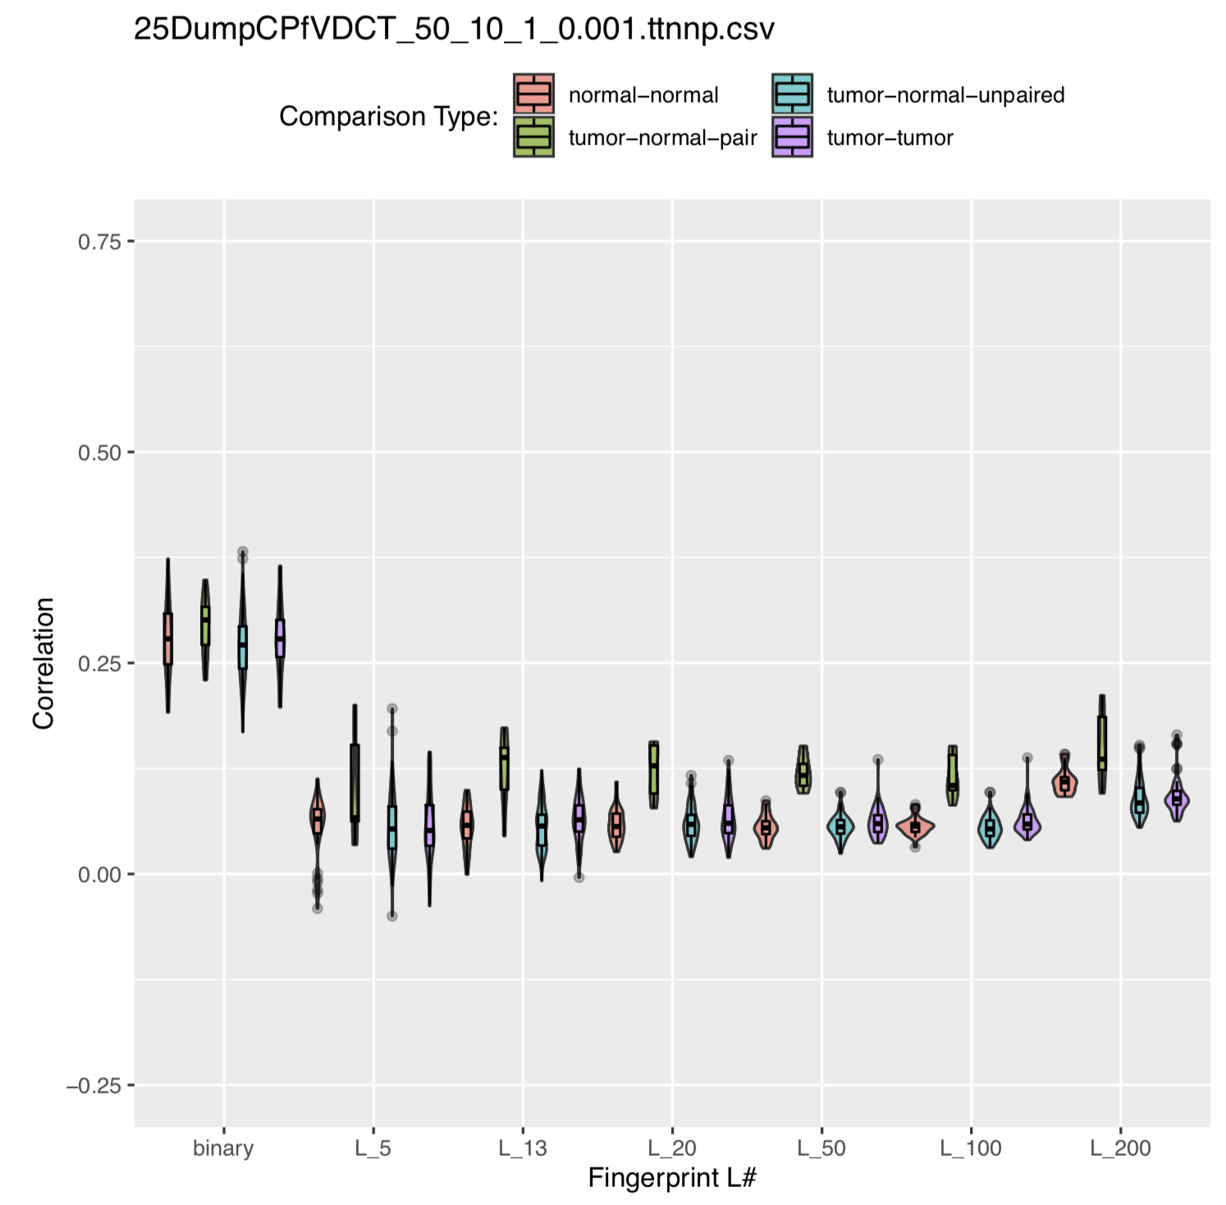
Correlations for Different Comparison Types for Vardict Only in the 25-Sample Dataset

Slide 35
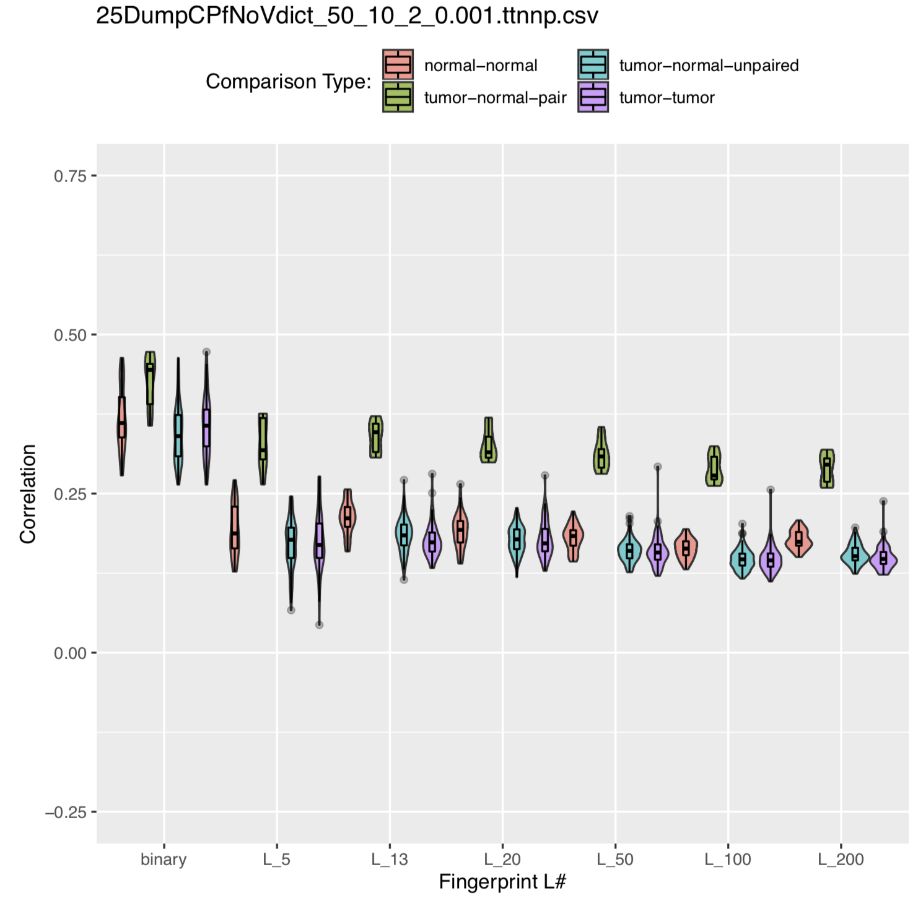
Correlations for Different Comparison Types for All Callers but Vardict in the 25-sample Dataset

Slide 36
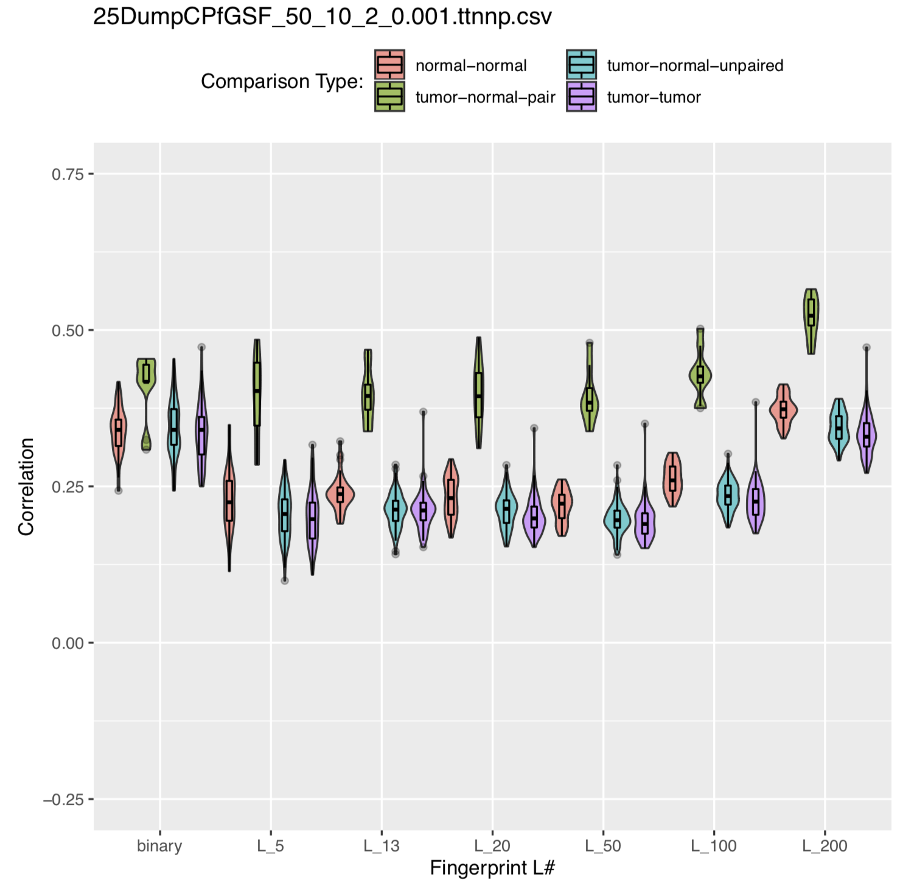
Correlations for Different Comparison Types for GATK and Freebayes Only in the 25-sample Dataset

Slide 37
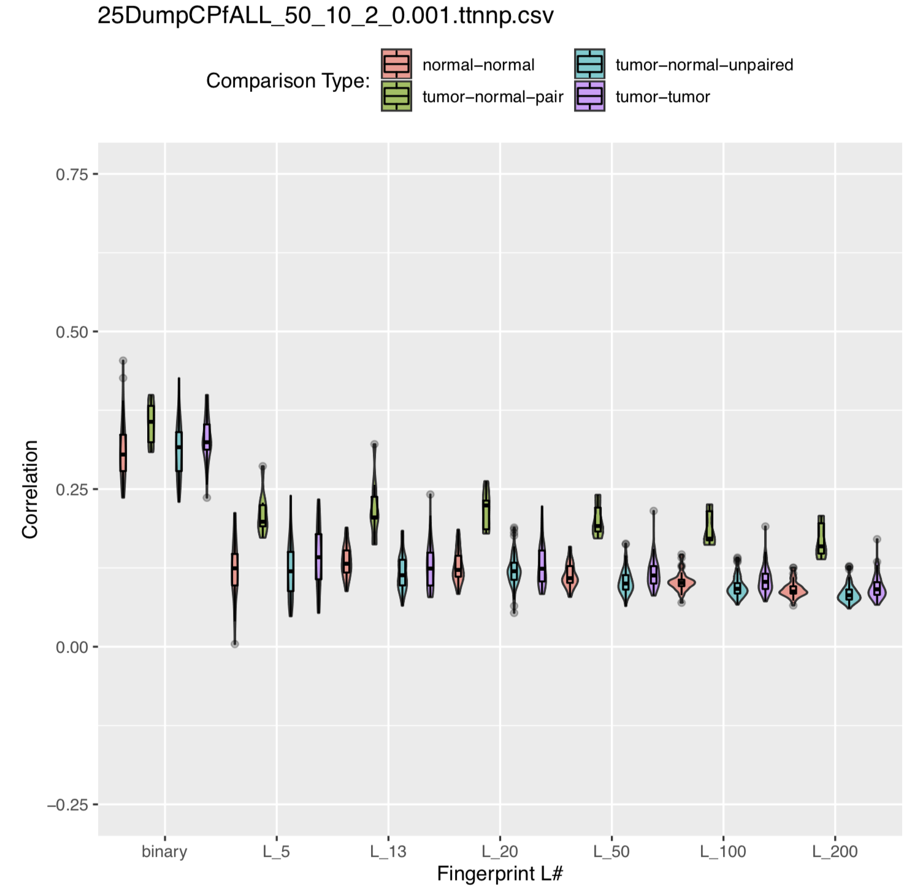
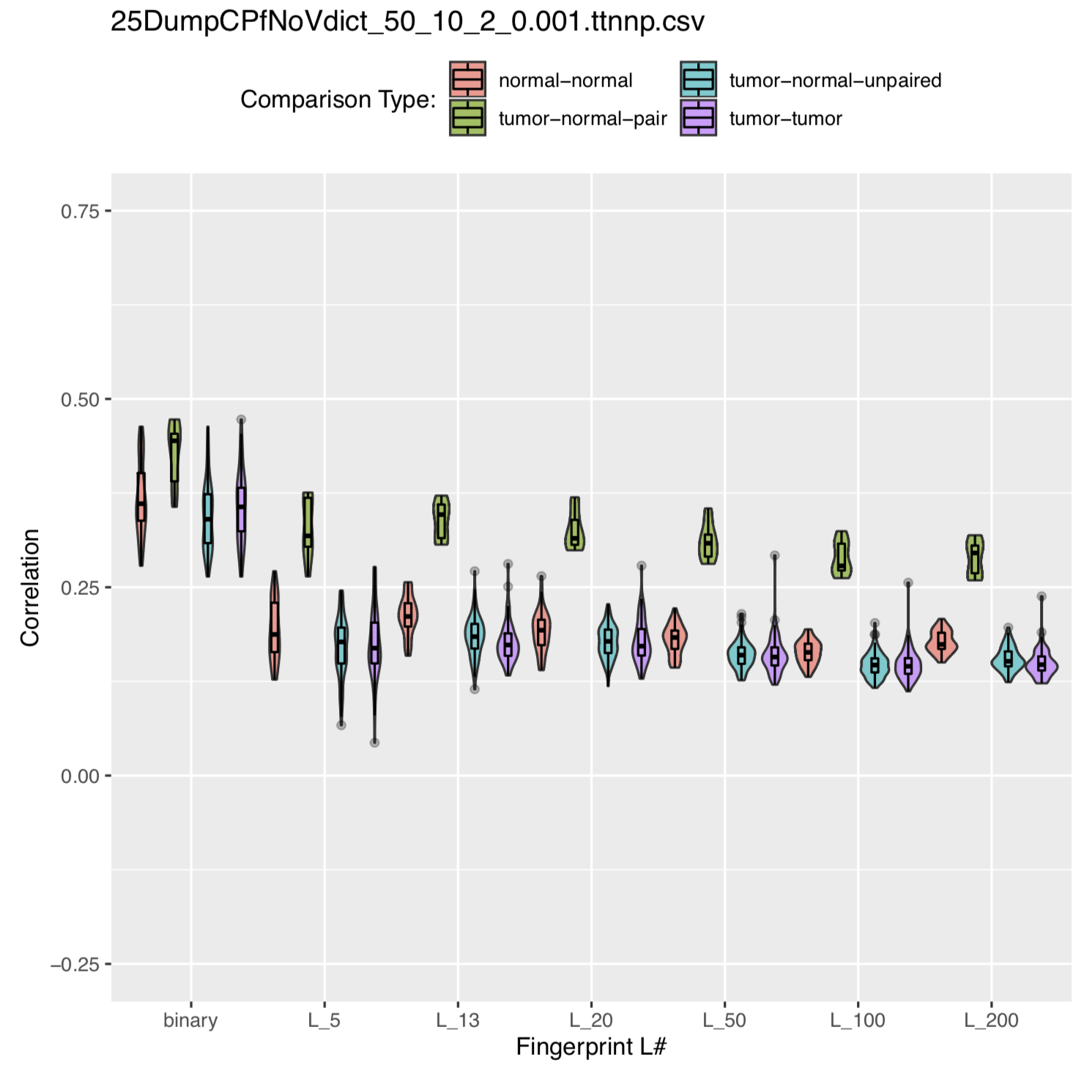
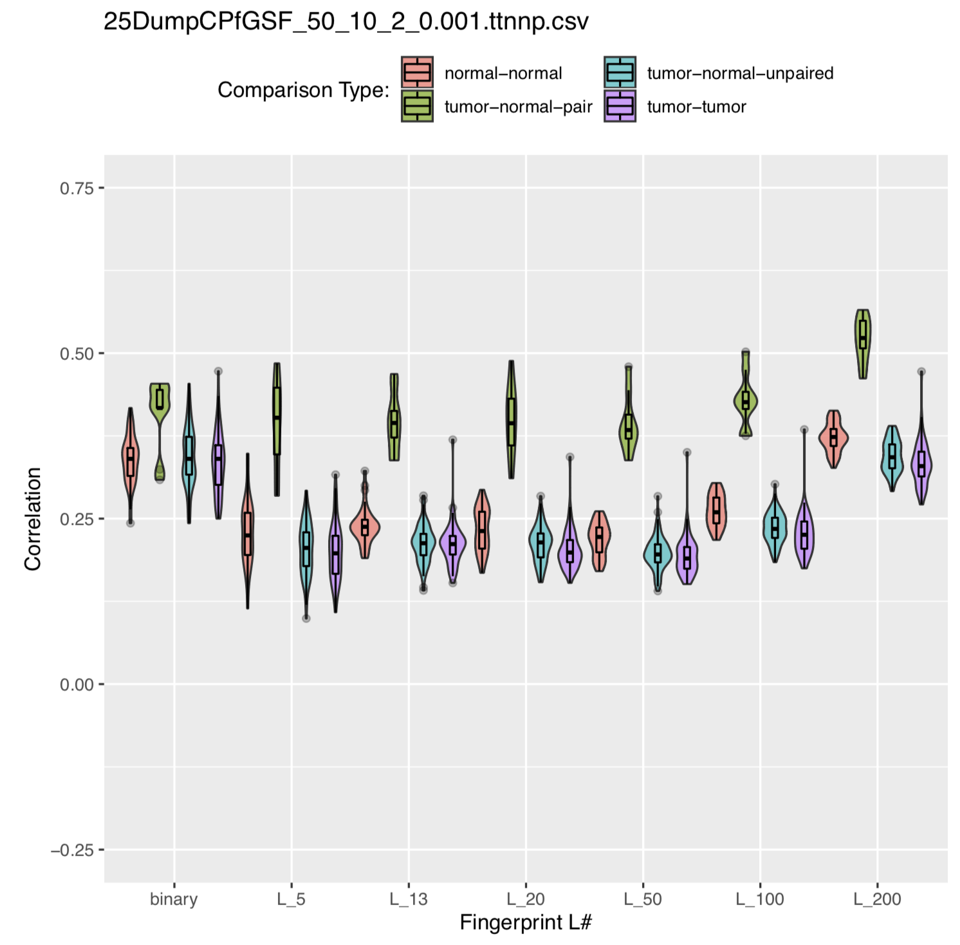
How Different Filters Effect Comparison Correlations:
All Callers
All Callers but Vardict
GATK and Freebayes Only
Good, tight distribution for each group
Poor Separation between tumor-normal-pair and tumor-normal-unpaired
Removing Vardict improved separation across the board while keeping a tight distribution
Correlation is still too low for tumor-normal-pairs, however
Correlations for tumor-normal-pairs are improved
This improvement was at the cost of tight distributions

Slide 38
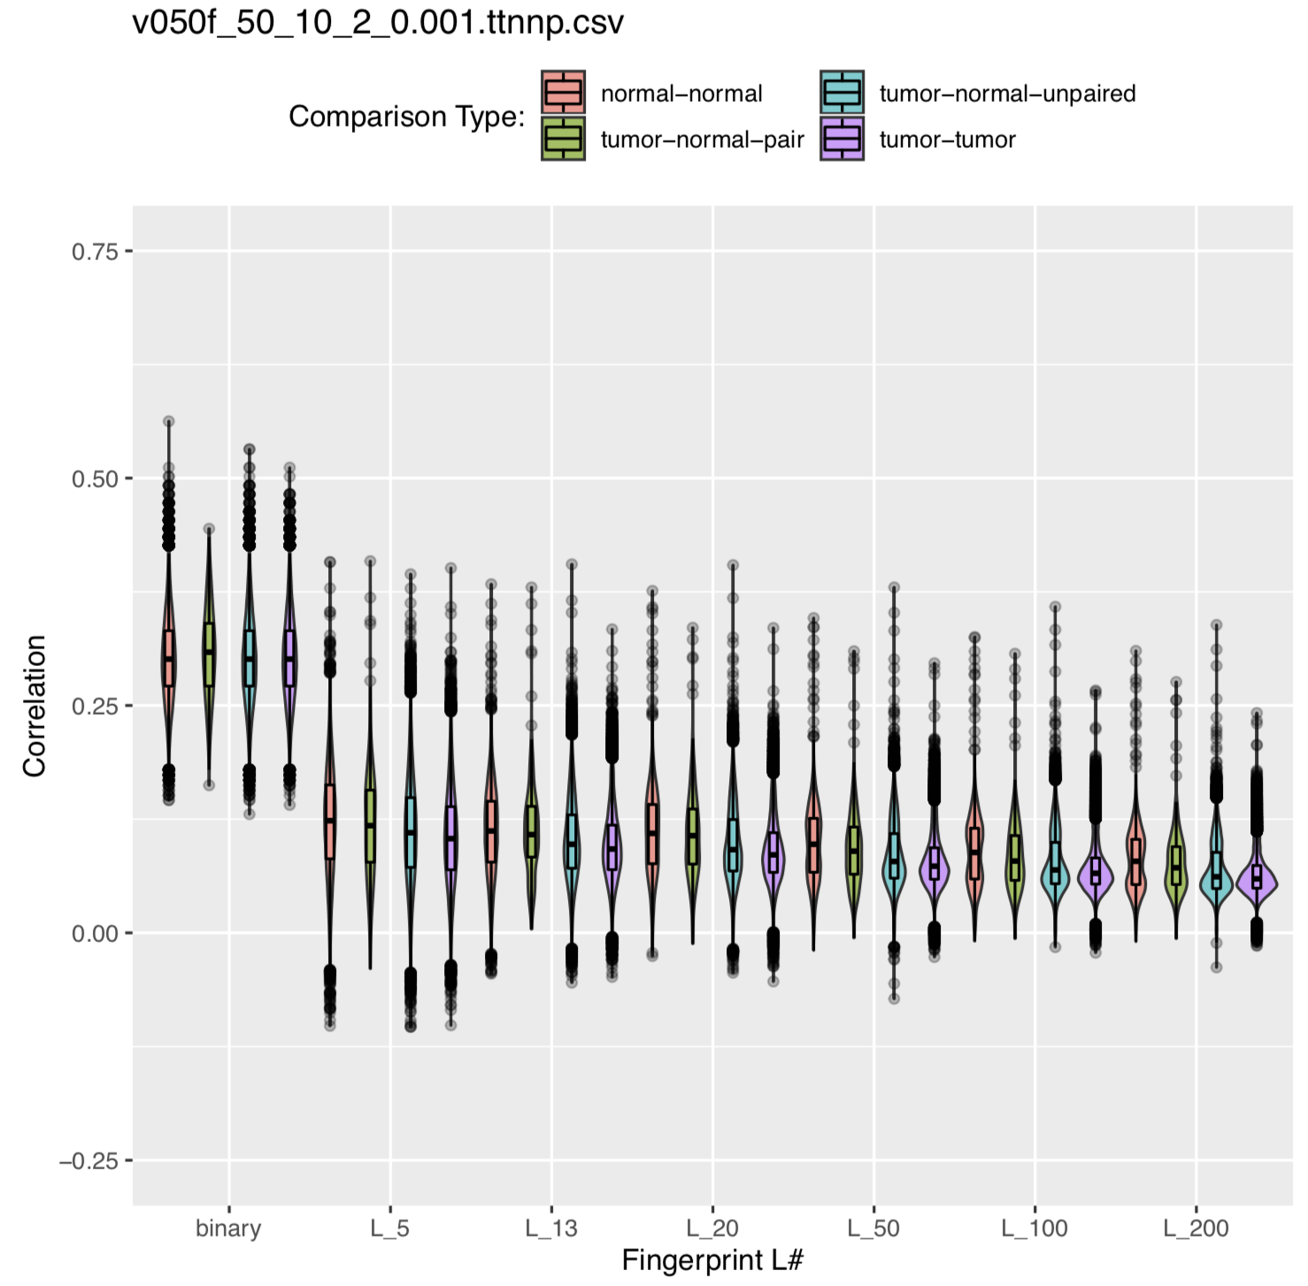
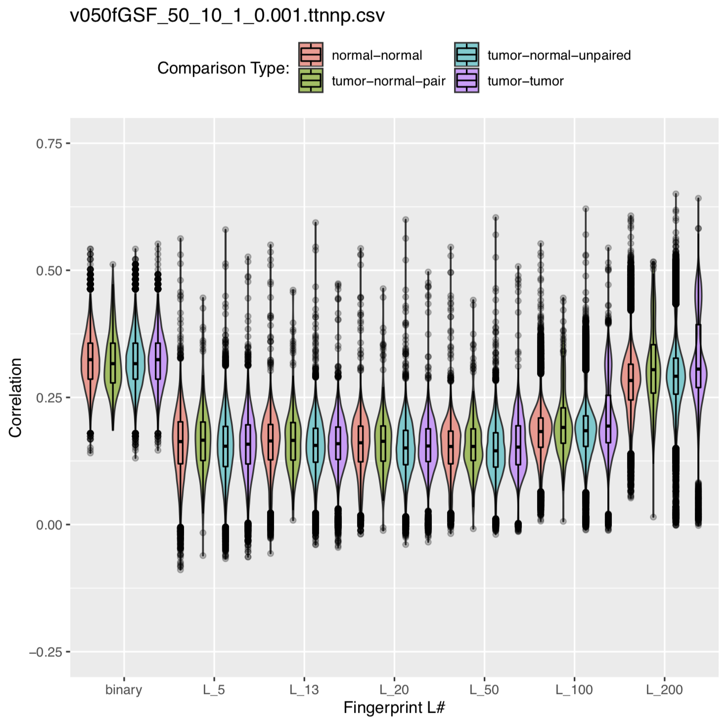
Adding Caller Filters to the v050 758-Sample Dataset:
SNV Filters Only:
Caller and SNV Filters:

Slide 39
That didn’t work… So what next???

Slide 40
Let’s do some Troubleshooting!

Slide 41
So adding filters filters for Caller Algorithm did improve our data, but it did not eliminate the outliers as we expected. Lets dig into some of these outliers…

Slide 42
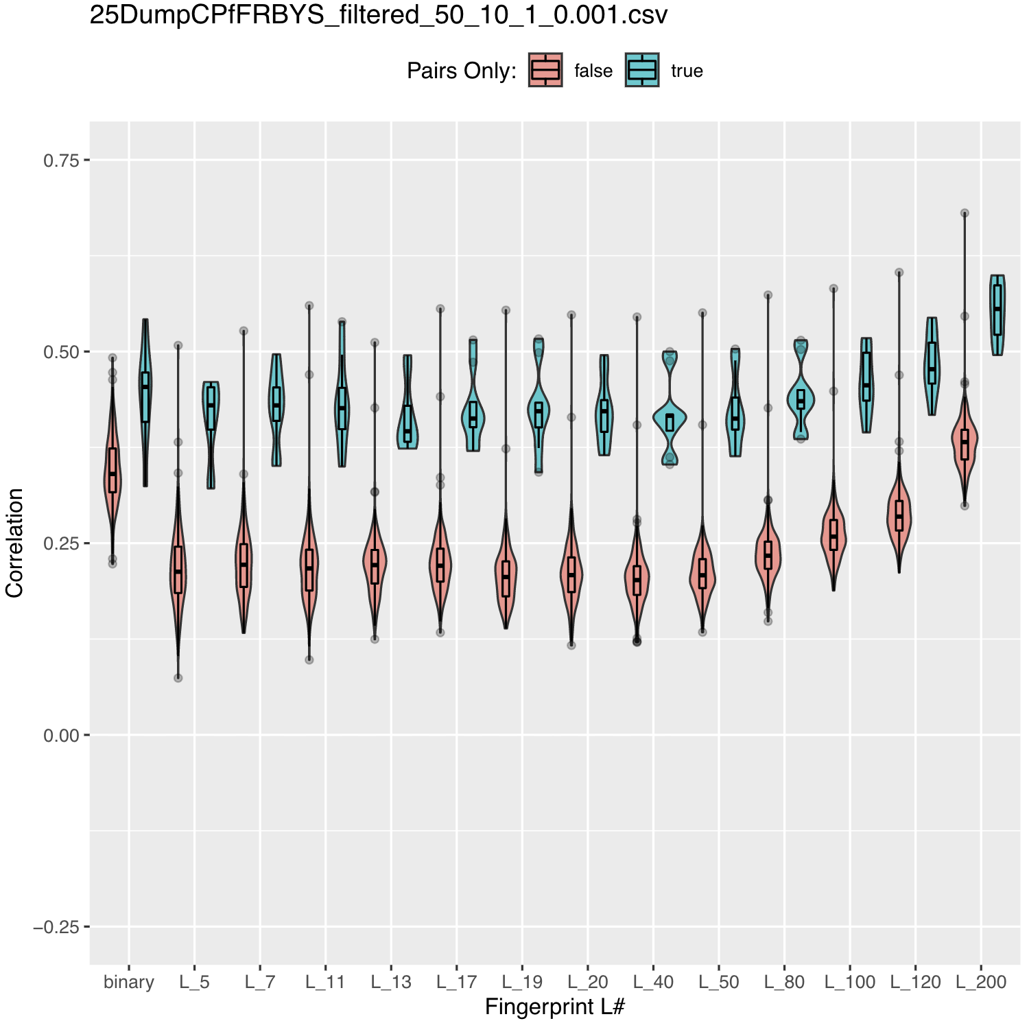
Look at the outliers in this graph
This graph was created by taking the comparison data and giving each comparison the value ‘true’ if it is a pair and the value ’false’ if it is not.
Notice the two very high outliers in the ‘false’ category

Slide 43
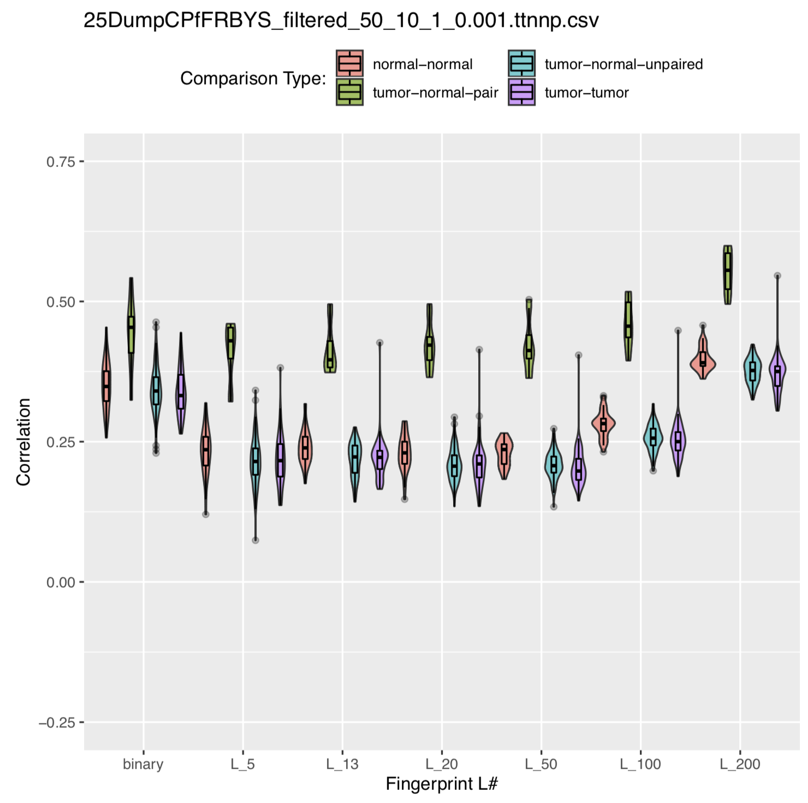
However…
Once the data is ported over to the four category graph, the largest outlier disappears.
This is because this graph only includes comparisons where BOTH samples being compared are in the tumor-normal key

Slide 44
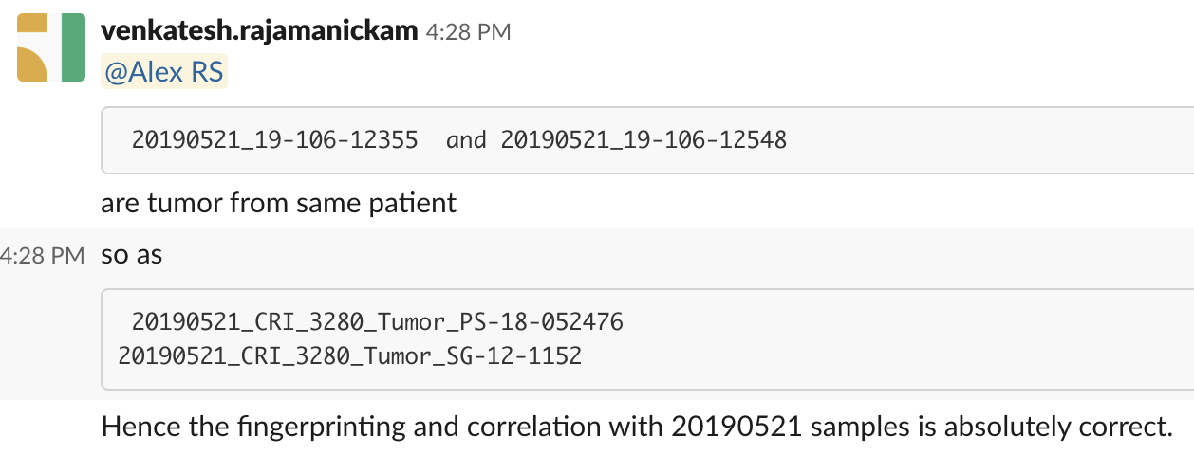
Confirming this result…

Slide 45
So noise can be introduced by pairs that are not found in the keys provided to the script
This is, in part, a product of transitions
The EACRI is transitioning from AWS to GCP. Datasets can be fragmented, partially transferred, or not transferred at all.
The Tumor-Normal-Key table found in pshj-eacri-data GCP project does not include all tumor-normal pairs in the 758 samples of the v050 dataset.

Slide 46
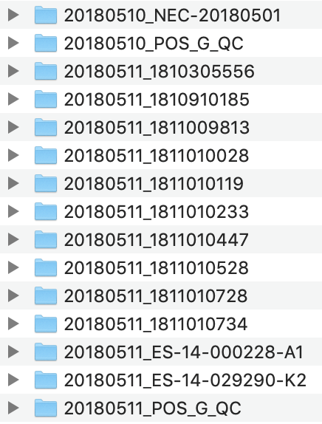
This is not the whole story: Positive Controls can also introduce comparison noise
Many samples, labelled ‘QC,’ ‘NEG-QC,’ or ‘POS-x’ in the v050 dataset are positive controls
They have tumor normal pairs in the key, but the same positive controls sequenced at different time periods or different positive controls can have high correlations when compared.

Slide 47
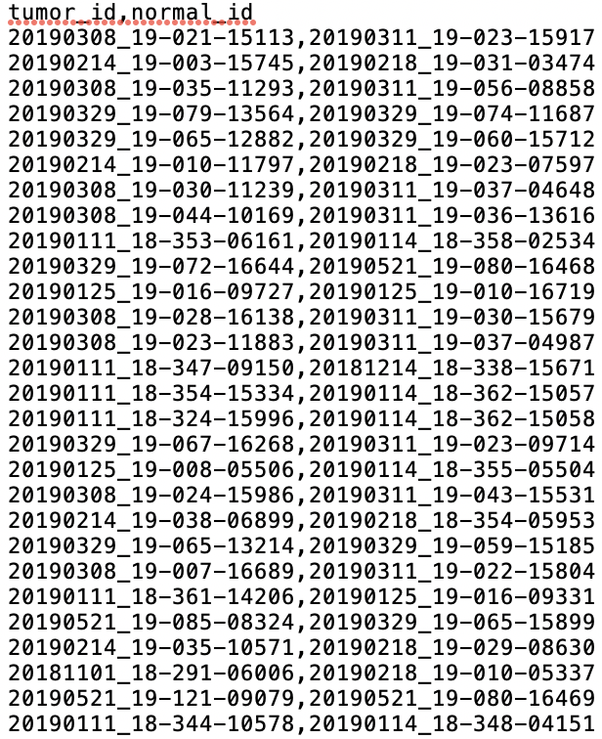
The solution: a set of 54 pairs provided by Venkatesh. When comparison data is filtered by this set, positive controls and unwanted pairs will be eliminated

Slide 48
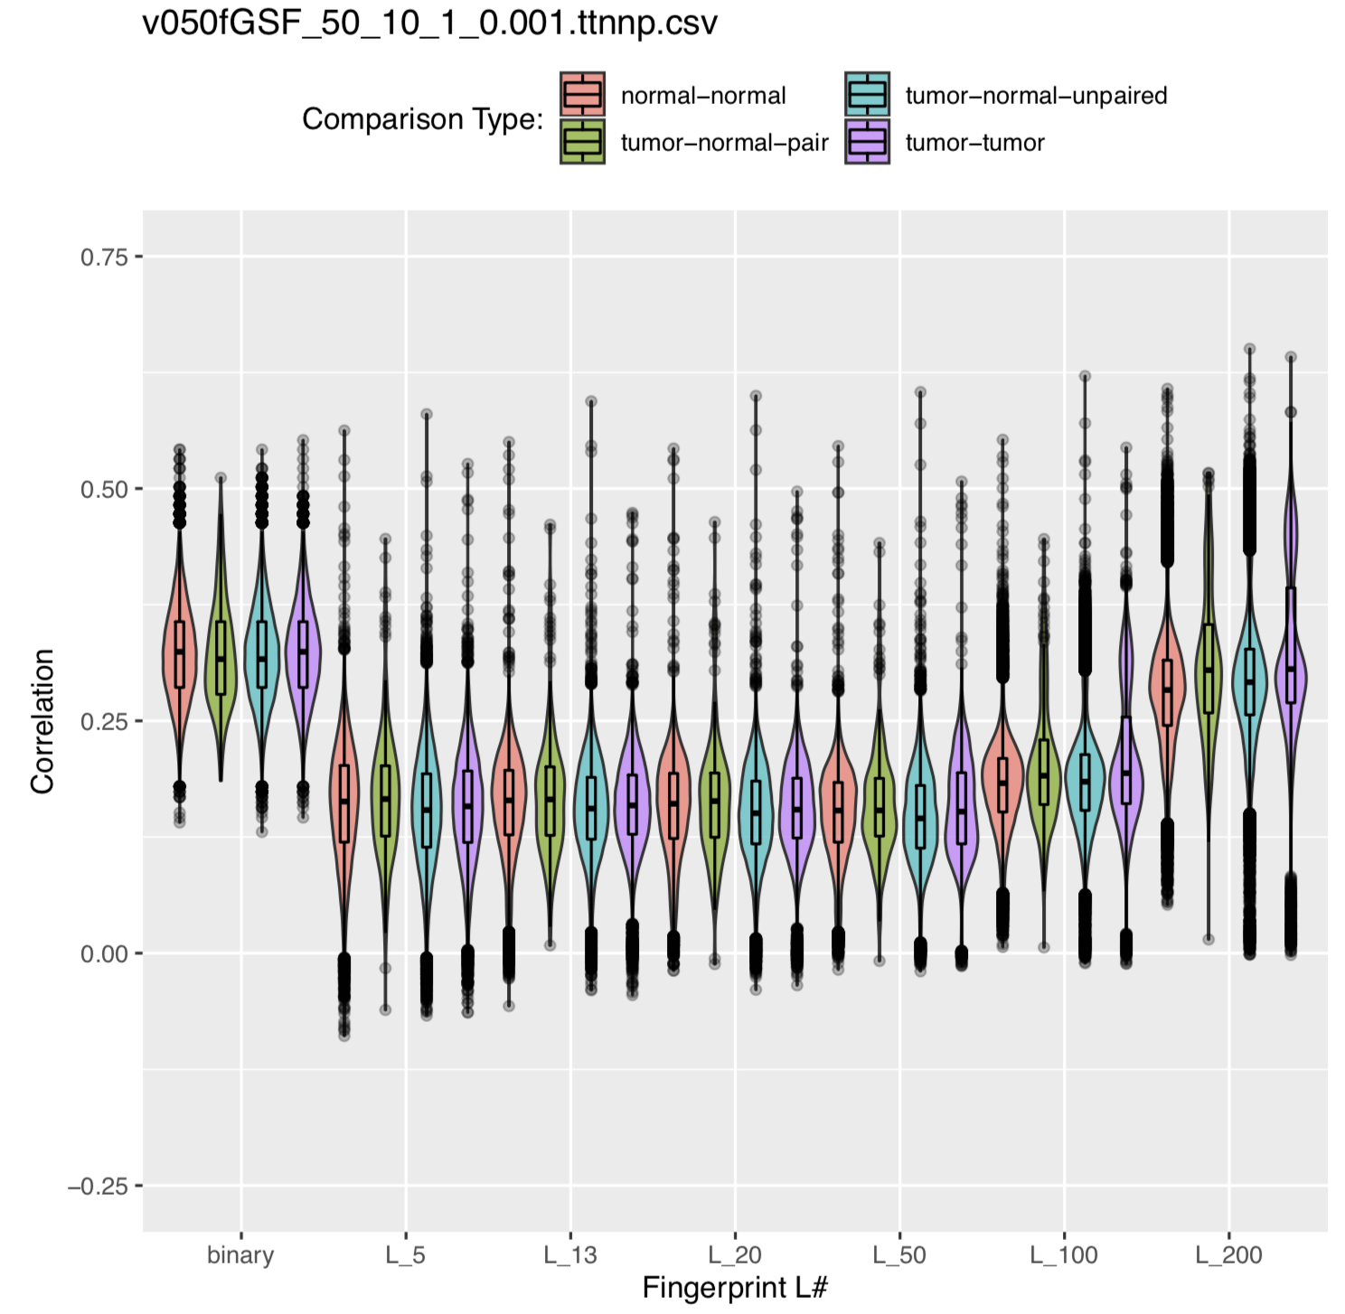
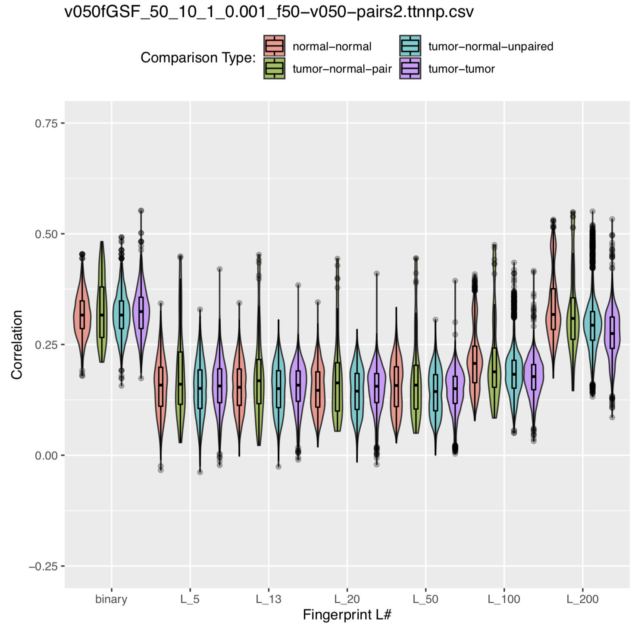
Using this new 50-pair key:
Using the original Key:
Filtered by the 50-pair key:
Filtering comparison data for samples only found in the 50-pair key reduced spread and outliers.
Separation is still atrocious, however

Slide 49
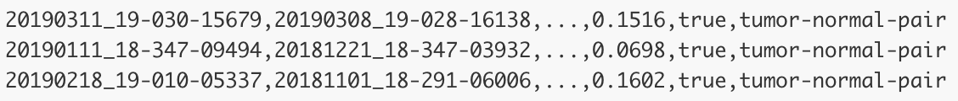
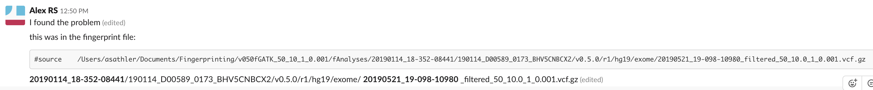
Okay, but we still have issues. Some tumor-normal-pairs have correlations that we would expect, but others have correlations that are far too low.
Essentially, the filtering script was filtering one .vcf and assigning it the name of another
This was the result of some samples being in multiple runs – this only occurred 2 in the entire pipeline but it skewed many of the fingerprints and their comparisons

Slide 50
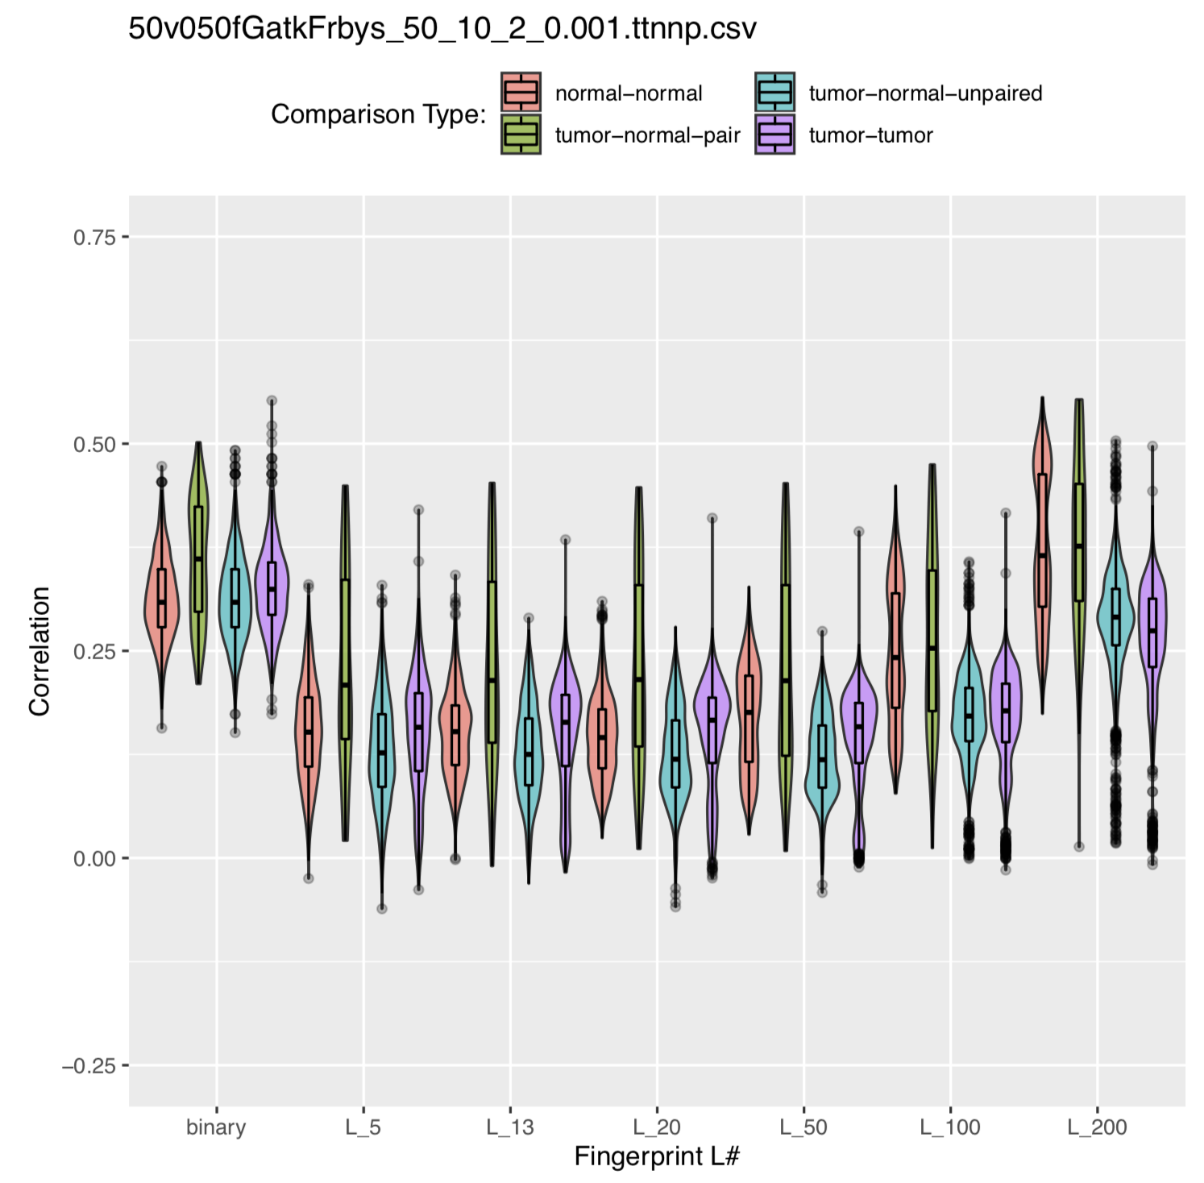
After reorganizing arrays & deleting duplicate runs for the same sample…
Before Fixing the Script
After Fixing the Script
The tumor-normal-pair samples are now more eveny distributed and no longer have denser distribution at low correlations.
Normal-Normal is now high correlation and TNP still has low correlation samples…

Slide 51
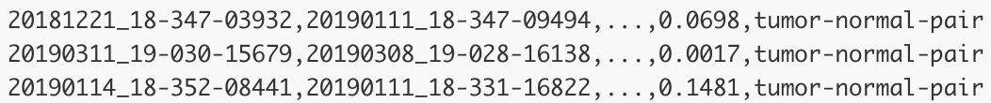
Back to our buddy awk: Let’s Find Tumor-Normal-Pairs with low correlations again.
Look into it, 09494 is a tumor sample and 03932 is a normal sample. The following two files are a list of SNVs in each .vcf post-filter:
After counting the lines in each file:
09494 (tumor): 550 SNVs
03932 (normal): 10,000 SNVs
Both samples starting with 260,000+ SNVs, so tumor had far fewer SNVs that passed the filter despite:
Tumor samples generally having higher read depth at all loci
Both samples being filtered by GATK to eliminate the majority of somatic mutations

Slide 52
Why might the SNVs in the Tumor sample .vcf have so much trouble passing the filter?
It shouldn’t be allele depth because tumors have very high read depth compared to normal.
Minimum variant allele frequency of 10% might be suspect, but Germline SNVs that passed the filter in the Normal Sample should also be found in the Tumor Sample – This isn’t the case though. Of the 550 SNVs that passed the filter in the tumor sample, only 3 of these SNVs were shared with Normal.
Maximum population allele frequency also should not have much of an effect. Tumor SNVs are rarer than normal SNVs, but mostly Germline SNVs should be called by

Slide 53
So what’s the problem?
It doesn’t seem to be the filtering script: the method works great for smaller datasets. The problem begins when larger datasets are tested.
Does some unique problem that occurs during sequencing explain why some tumor samples have different Germline SNVs than normal samples?
Is it an issue with the fingerprinting method? Or does it just not work for this purpose?
Is there something about my method that I am missing?
Please feel free to share your thoughts if you have any!

Slide 54
Next Steps:

Slide 55
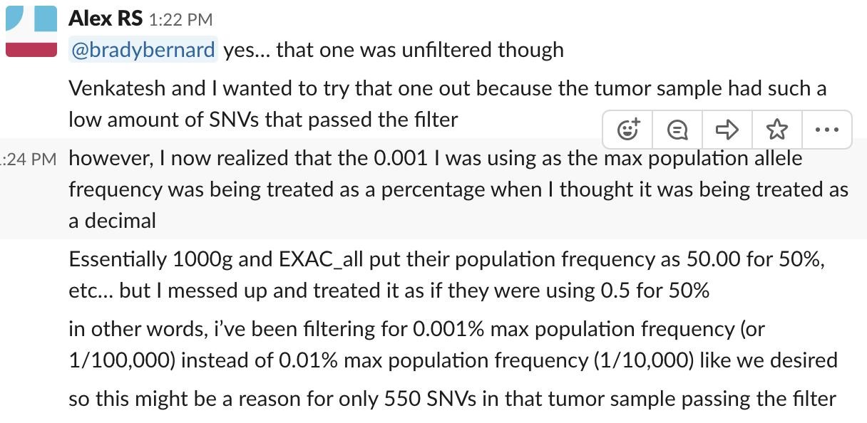
What is wrong with the current method? There was an issue with maximum population frequency – will this fix the problem?
-- Redacted --

Slide 56
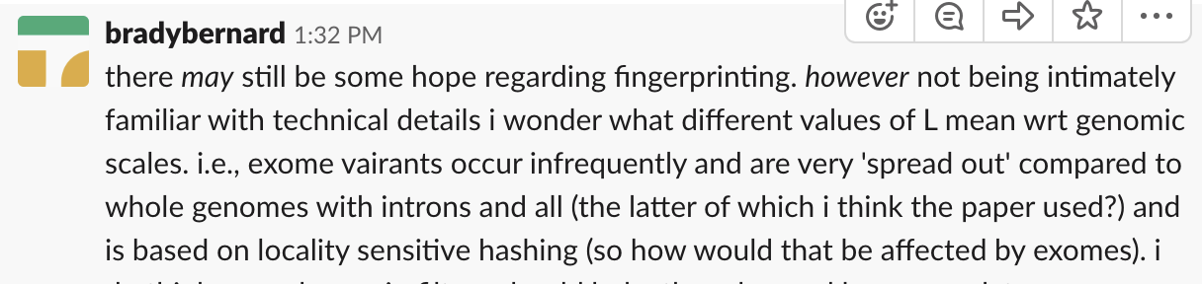
Is the problem that the method seemed to be proved on WGS not WES?

Slide 57
Generalizing the method: fingerprinting and comparing across two assays (e.g. WES vs TST170)

Slide 58
Cloud precision: as new samples come in, fingerprint them and add their fingerprints to GCP. Automatically compare each new fingerprint (tumor and normal) to all other existing fingerprints

Slide 59
Number of somatic mutations vs germline mutations. Distribution for each for each caller.

Slide 60
How are tumor-tumor correlations for different/same types of cancer from the same patient? From different patients?

Slide 61
Lessons Learned and Final Thoughts…

